Slide 1
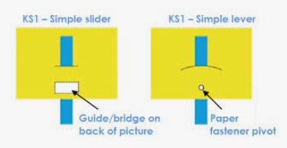
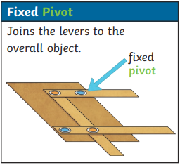

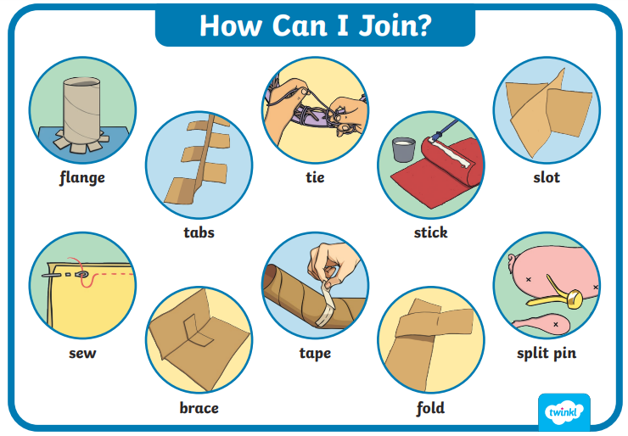
Design and Technology Knowledge Organiser Year 1 Mechanisms – Levers & Linkages
Firework Pictures
ESSENTIAL VOCABULARY
Mechanism | Mechanisms are the parts that make something work.
Lever | A lever is a stiff bar which moves around a pivot
Slider | A rigid bar which moves backwards and forwards in a straight line.
Slot | A long narrow opening, groove, or passage
Pivot | A shaft or pin on which something turns.
Making tape | A tape that is sticky on one side and that has many uses
Split pin/ Paper Fastener | A metal pin that it can be passed through a hole to secure another part by bending back the ends of the wire.
Pull | A pull is the force of bringing an object closer.
Push | A force that moves an object away from something.
Straight | A line with no bends or curves.
Design | To design is to create, sketch out, or invent something.
Plan | The way that you are going to do something, thought of before you do it.
Investigate | To look into something carefully and closely to learn something.
Evaluate | To judge how good or bad something is.
Process | A procedure, something you do in order to achieve a certain result.
Overview
. Children will… Know how to operate moving books and pictures. Know about mechanisms such as sliders and levers, including how to make and operate them. Know how to push and pull and how to move right, left, up, down, forwards, backwards, in and out. Know how a mechanism can be used to create a movement.
Sliders and Levers
Technical Knowledge and Skills Making
Cut materials using scissors. Join materials together as part of a moving product using tape and split pins.
Evaluating
Which mechanism have you used? Does it work well? What went well with your moving picture? Would you improve anything next time?
© Vocabulary Ninja Ltd 2021

