Slide 1



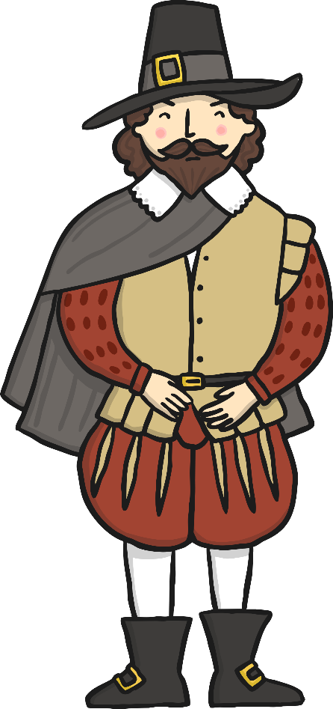

Remember, Remember!
KNOWLEDGE ORGANISER
ESSENTIAL GUNPOWDER PLOT VOCABULARY
gunpowder | An explosive powder used in guns.
plot | A plan made in secret by a group of people to do something often illegal or harmful.
treason | A crime that betrays your country.
conspire | To make secret plants to commit an unlawful or harmful act.
plotters | A group of people planning to do something illegal or harmful.
barrel | A container normally made of wood with metal hoops around them.
parliament | The group of people responsible for making the laws.
bonfire | A large open-air fire.
London | The capital city of England and the United Kingdom.
government | The group of people who lead or govern a country.
justice | Treating people fairly.
past | Something that has already happened.
present | Something that is happening right now.
remember | To think of something again.
Events of the Gunpowder Plot
Robert Catesby starts the plot. He gets a groups of men to help him with his plot to blow up King James 1. | Digging the tunnel. Guy Fawkes and Thomas Percy find a house close to Parliament and dig a tunnel underground to Parliament. | Gunpowder in the cellar. A cellar directly under where King James will be sitting becomes available. The men move 36 barrels of gunpowder into the cellar. | Lord Monteagle’s letter. Lord Monteagle, an important friend of King James, is given a letter to stay away from Parliament on 5th November. | Guy Fawkes in the cellar. Guy Fawkes waits by the gunpowder in the cellar. Guards find him and arrest him. | The search for the plotters. Guy Fawkes is captured but doesn’t give the name of the other plotters for 2 days. They are captured and killed.
What was the Gunpowder Plot?
It was a plot to kill King James I and his government by blowing up the Houses of Parliament.
Who was involved?
Guy Fawkes (a gunpowder expert) Robert Catesby (the leader) Thomas Percy (one of the royal bodyguards) John Wright (friend of Robert Catesby) Christopher Wright (friend of Robert Catesby) Robert Winter (cousin of Robert Catesby) Thomas Bates (servant of Robert Catesby)
Why were they plotting?
Under James I’s reign, Catholics were not treated fairly. The people involved in the plot wanted to have James I removed from the throne to improve treatment of the Catholics and make life fairer for them.
Thwarting of the Plot
An anonymous letter was sent to Lord Monteagle to warn him not to go to the Houses of Parliament on the 5th of November. He sent guards to check the cellars and they found Guy Fawkes hiding there with the gunpowder.
Gunpowder Plot Poem
Remember, remember, the 5th of November The gunpowder treason and plot. I see no reason why the gunpowder treason Should ever be forgot.
What happened to the plotters?
They were found guilty of treason (trying to kill of overthrow the monarch or government), tortured and executed.
What happened to the plotters?
The Gunpowder Plot happened in 1605, over 400 years ago! Life was very different in 1605 to now. Electricity hadn’t been invented yet, so there was no electrical items. There were no cars, people travelled in a horse and carriage. Men always wore hats, usually indoors as well!
Present Day
The king ordered bonfires to be lit on the 5th of November to celebrate the Gunpowder Plot not going ahead. People still light bonfires and burn ‘guys’ (models in the shape of a man) to celebrate. They often set off fireworks as part of the celebrations.
© Vocabulary Ninja Ltd 2021

