Slide 1
11 Club - 11 questions involving doubling numbers from one to ten
22 Club - 22 questions involving repeated addition of numbers from one to ten
33 Club - 33 questions introducing the 2x, 3x, 5x and 10x tables
44 Club - 44 questions adding the 1x, 4x and 6x tables
55 Club - 55 questions adding the 7x and 8x tables
66 Club - 66 questions adding the 9x, 11x and 12x tables
77 Club - 77 questions consisting of inverse division facts
88 Club - 88 questions of mixed multiplication and division facts
99 Club - 99 questions of mixed multiplication and division facts
Bronze Club – 100 mixed multiplication and division facts
Silver Club - 100 mixed multiplication, division, addition and subtraction facts
Gold Club-100 mixed multiplication, division, addition and subtraction facts plus questions involving square and cubed numbers.
Platinum Club-100 mixed multiplication, division, addition and subtraction facts, plus questions involving square and cubed numbers, Roman numerals, BIDMAS, degrees in shapes and algebra

Slide 2

11 Club
Name:___________________ Date:________
3+3= | 7+7=
2+2= | 1+1=
5+5= | 8+8=
6+6= | 0+0=
9+9= | 10+10=
4+4=
Notes:
x2 5 mins

Slide 3
22 Club
Name:___________________ Date:________
1+1+1= | 2+2+2+2+2=
4+4+4+4+4= | 0+0+0+0=
6+6+6= | 3+3+3+3=
3+3+3+3= | 2+2+2=
2+2+2+2+2+2= | 8+8+8=
0+0+0= | 10+10+10=
2+2+2+2= | 7+7+7+7=
8+8+8+8+8+8= | 9+9+9=
10+10+10+10= | 1+1+1+1=
7+7+7= | 4+4+4+4=
9+9+9+9= | 6+6+6+6=

Slide 4
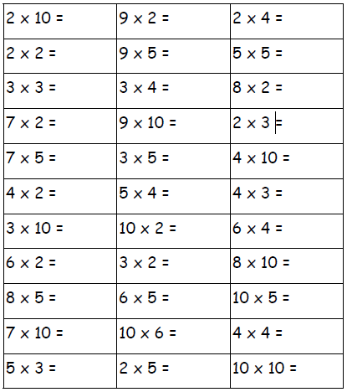
33 Club
Name:___________________ Date:________
Notes:
3/4

Slide 5
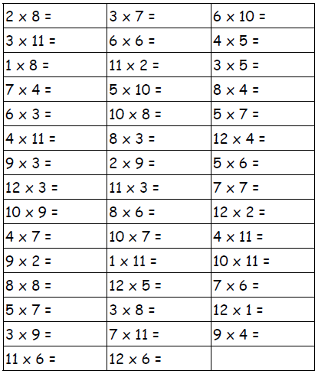
44 Club
Name:___________________ Date:________
Notes:
6s/7s

Slide 6
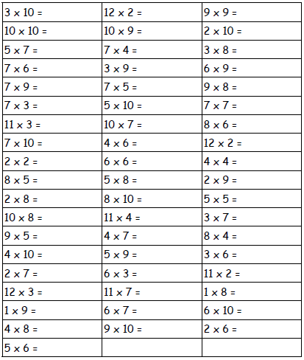
55 Club
Name:___________________ Date:________
Notes:
Any above 7s

Slide 7
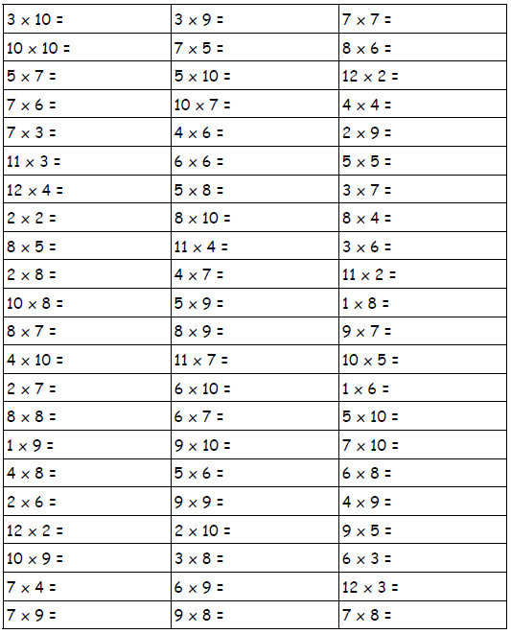
66 Club
Name:___________________ Date:________

Slide 8
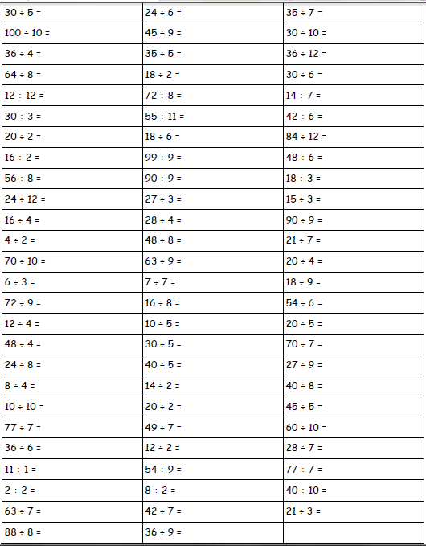
77 Club
Name:___________________ Date:________

Slide 9
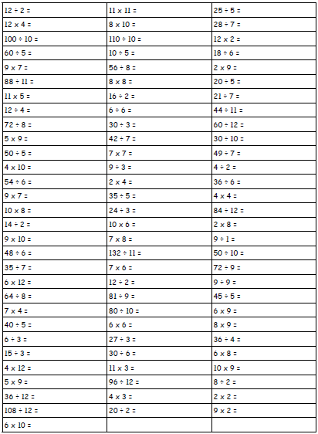
88 Club
Name:___________________ Date:________

Slide 10
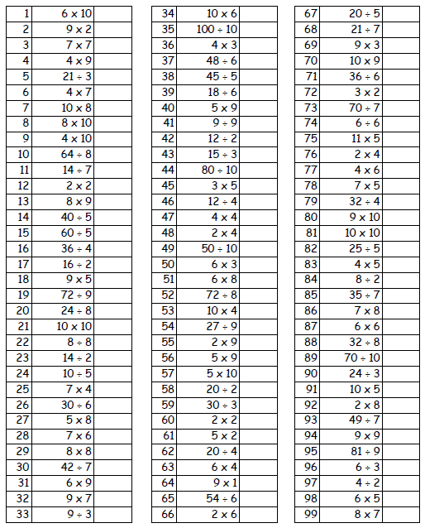
99 Club
Name:___________________ Date:________

Slide 11
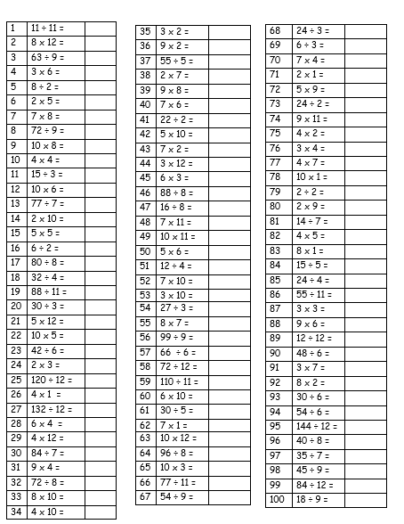
Bronze Club
Name:___________________ Date:________

Slide 12
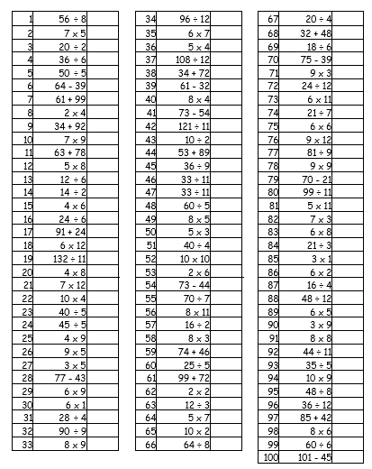
Silver Club
Name:___________________ Date:________

Slide 13
Gold Club
Name:___________________ Date:________
√400 |  | 15÷2 |  | 16 x 3
7 x 8 |  | 50 x 17 |  | 10 x 18
30 x 2 |  | 560 ÷ 7 |  | 9 x 1.5
16 x ½ |  | 256÷80 |  | 10% of 11
8 x 7 |  | 14(5) |  | 13 x 12
48÷16 |  | 28 x 0.25 |  | 135 ÷9
256÷4 |  | 48 x 2 |  | 1280÷2
¾ of 80 |  | 0.25 x 28 |  | 10²
5 x 2.2 |  | 560÷8 |  | 1.5 x 9
20 x 3 |  | 2560÷80 |  | ½ x 16
64 x 0.5 |  | 10³ |  | √25
20² |  | 156÷13 |  | 1³
256÷8 |  | 9 x 15 |  | 2 x 48
17 x 5 |  | √100 |  | 2.2 x 5
6 x 19 |  | 128÷64 |  | 7²+15
0.5 x 200 |  | 1² |  | 5 x 170
½ of 200 |  | 0.5 x 17 |  | 230÷1000
85÷5 |  | 12 x 13 |  | (6x2)+8
600÷2 |  | 28 x 0.5 |  | 230÷100
128÷2 |  | 0.6 x 100 |  | 3 x 16
¼ of 80 |  | 2³+3² |  | 34 x 20
2 x 30 |  | ½ of 80 |  | 50% of 200
19 x 6 |  | 3 x 20 |  | 5(14)
8 x 8 |  | 11 x 11 |  | 6+8x2
300 x 11 |  | 63 x 5 |  | 210÷70
660 ÷ 33 |  | 6² + 2² |  | 699 x 1
20% of 72 |  | 1000÷100 |  | 54 x 3
(7+2)x8 |  | 0.5x6 |  | 5 x 63
660 ÷ 20 |  | 315÷63 |  | 100 x 10
10% of 72 |  | 1000 ÷10 |  | 333÷1
√81 |  | 0³ |  | 2²+6²
315÷5 |  | 333 ÷ 10 |  | 333÷10
3 x 54 |  | 5² + 6² |  | 33 x 20
4³+5³ |  | 20 x 33 |  | 699÷1
5³ |  | 10 x 100 |  | √36
4³ |  | 11 x 300 |  | √64

Slide 14
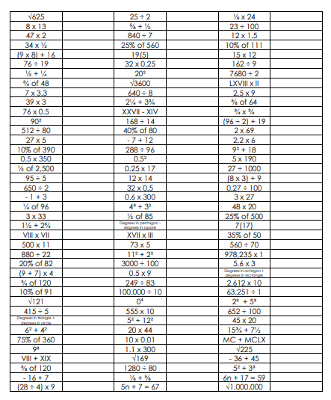
Platinum Club
Name:___________________ Date:________

