Slide 1
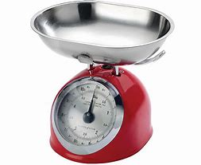

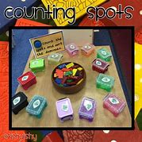

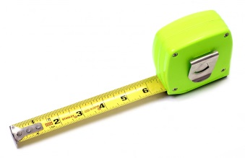

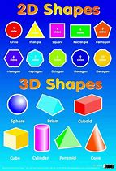

Early Maths at
Barden Primary School

Slide 2
Mathematics
in the Early Years
Mathematics is a specific area of learning. It is split into 2 aspects
Number
Numerical Patterns

Slide 3
Early Learning Goals
Number
Have a deep understanding of number to 10, including the composition of each number.
Subitise (recognise quantities without counting) up to 5.
Automatically recall (without reference to rhymes, counting or other aids) number bonds up to 5 (including subtraction facts) and some number bonds to 10, including double facts.

Slide 4
Early Learning Goals
Numerical Patterns
Verbally count beyond 20, recognising the pattern of the counting system.
Compare quantities up to 10 in different contexts, recognising when one quantity is greater than, less than or the same as the other quantity`.
Explore and represent patterns within numbers up to 10, including evens and odds, double facts and how quantities can be distributed equally.

Slide 5
How do children learn
Mathematics in reception?
Carpet session linked to Mathematics
Cross-curricular table top activities and outdoor activities
Lots of talking
Thinking
Self-discovery
Asking questions
Practical and engaging lessons
Using manipulatives
Problem solving
Booster groups
Songs
Stories
We follow Mastering Number and the White Rose Maths schemes of learning for maths teaching which covers our Statutory Framework. We also supplement our planning with other schemes and resources, such as NRICH and Numberblocks to deliver a broad and balanced curriculum, with plenty of challenge.

Slide 6
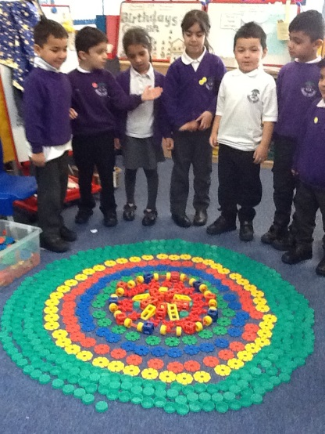
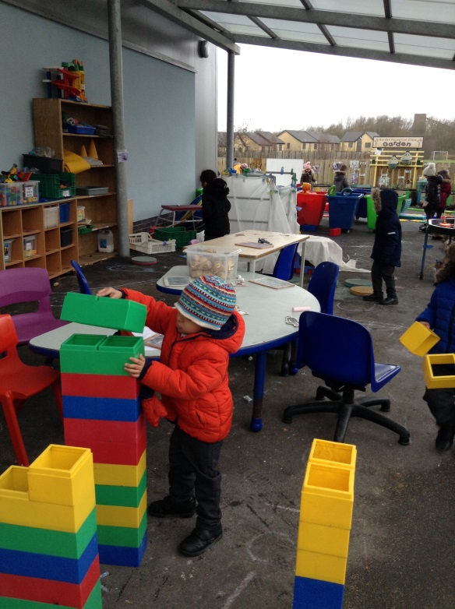
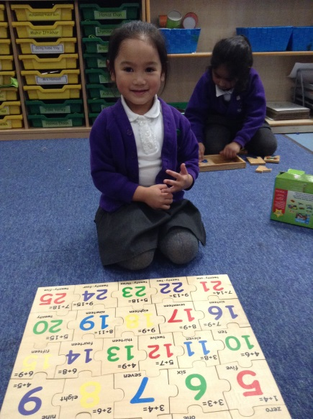
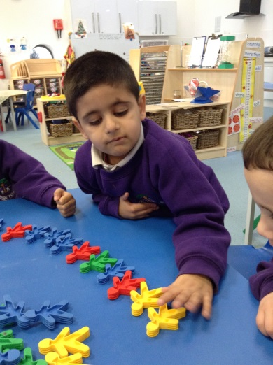
This learning is achieved by -
Adult-Led Play
Allows adults to model
mathematical skills and
introduce concepts
• Adults can focus on specific
aspects of learning and
address misconceptions
• Adults can demonstrate and
encourage the use of
mathematical language

Slide 7
Whole class Teaching
Teachers plan together to introduce and teach key concepts consistently across the year group.
Children work together to develop not only their mathematic abilities but general listening and attention skills
It allows teachers to teach and model skills, concepts and language and assess where more support may be needed.

Slide 8
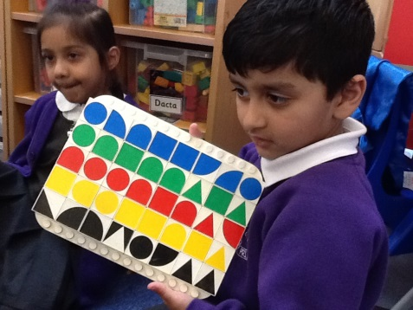
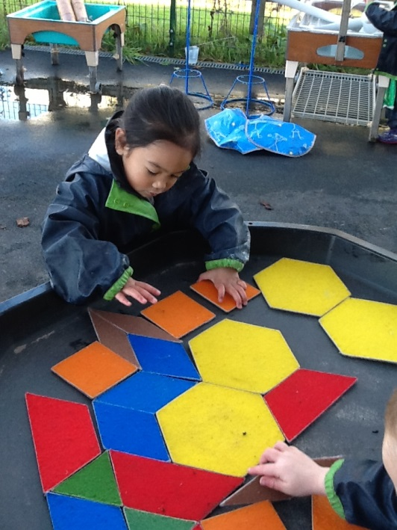
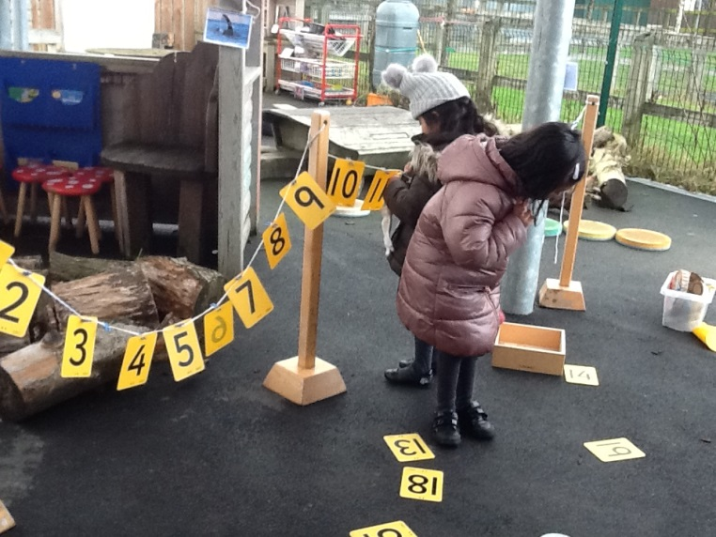
Child Initiated Play
Children choose their own mathematical learning
• Allows children to explore different approaches and reach
conclusions themselves
• It allows them to practice skills and language in a safe and personal way
• Encourages critical thinking, problem solving and perseverance

Slide 9

Magic Maths

Slide 10
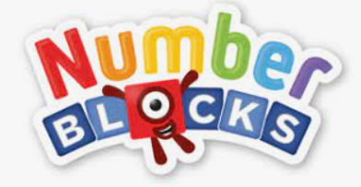

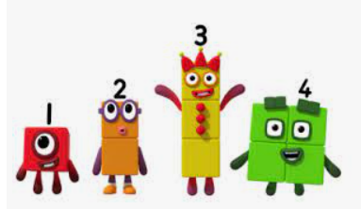


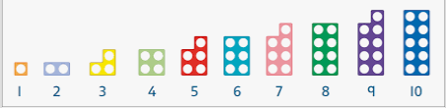

Slide 11
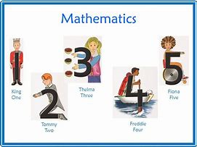
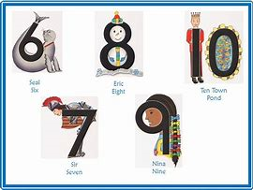
Ten Town

Slide 12
Everything turns into mathematical learning!
Notes:
Morning activities – temp , date, counting who is here, working out how many children in class, story time , time on the clock for lunchtime, 10 seconds, sit at the circle table, rectangle table , sit around the edge, line up on the long wall, stand behind …

Slide 13
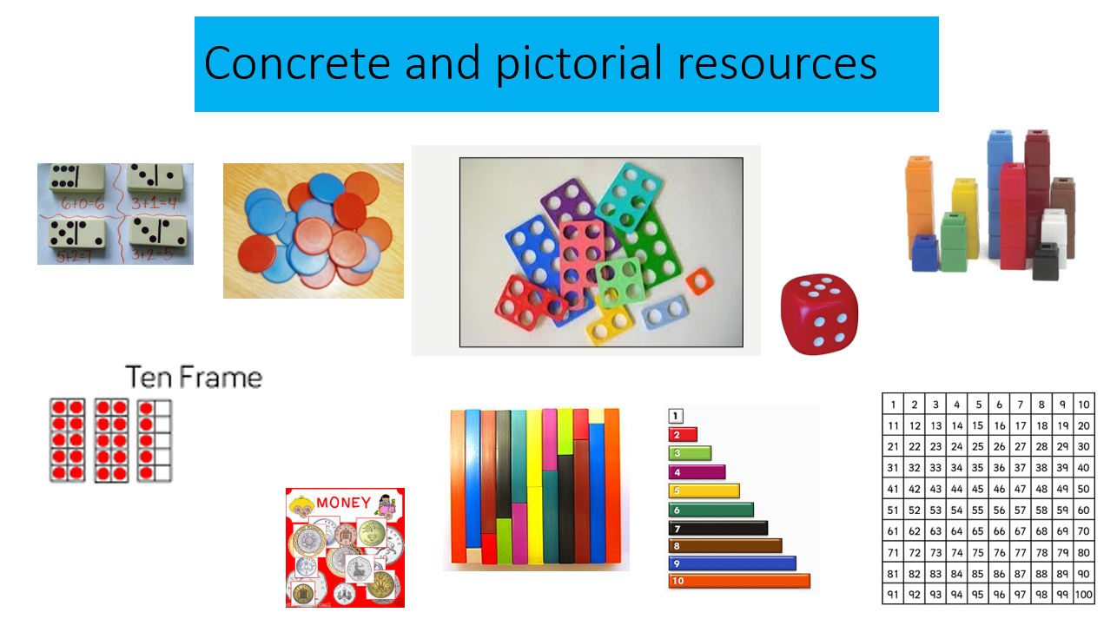
We believe children need plenty of opportunities to make connections between numbers and operations and to see, and then talk about, their discoveries and the patterns that emerge. A range of resources allow children to ‘see the maths’.

Slide 14
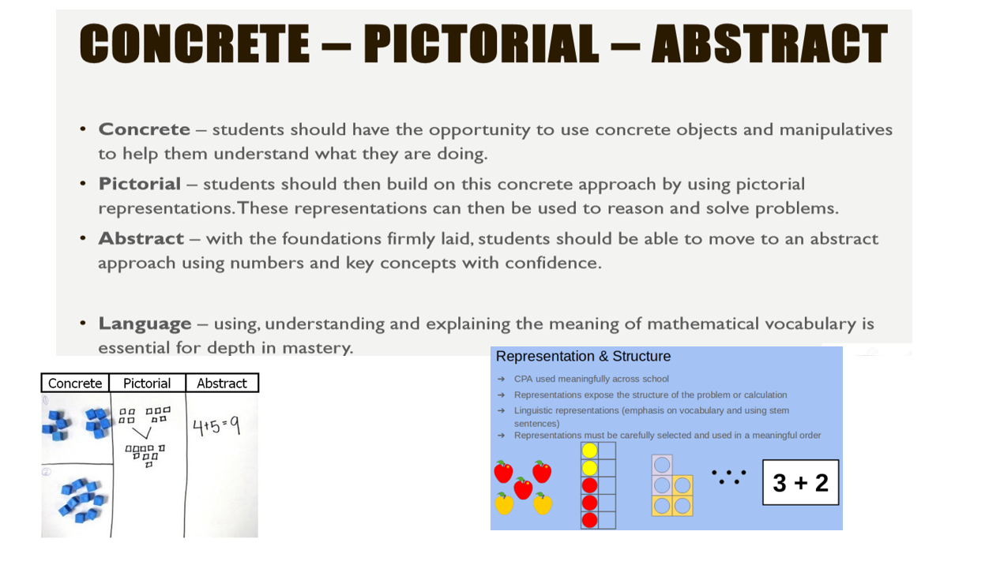

Slide 15
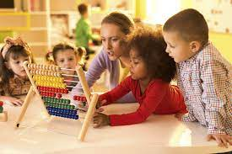
Early Numbers & Counting
• Vocabulary – talk, talk, talk !
• Children are encouraged to count – any spontaneous counting is encouraged
• Spontaneous counting becomes more refined
• Children will experiment saying random numbers and beginning to say numbers of personal significance
• Number rhymes/songs

Slide 16
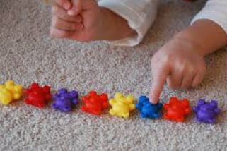
Moving on to move advanced counting
• one-to-one correspondence
• the same order
• anything can be counted
• it does not matter which object you start with when counting

Slide 17
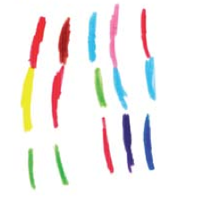
Problem solving and mathematical marks
• children making their own choice to represent their mathematical thinking
• children making their own meanings – both independent and co-constructed (rather than copied)
• children’s own graphics (drawings, writing, symbols, marks)
• children’s own layouts
• children challenging themselves as they explore their mathematical thinking and meanings, communicate their ideas and solve problems.

Slide 18
Calculation
• Compare groups/quantities using one-to-one
correspondence to find the difference – early
subtraction
• Share objects equally by counting how many in each
group – early division
• Count groups of the same number of objects and add
them together – early multiplication
• Count back from a fixed number when taking away –
subtraction
• Count on from a fixed number when combining two
groups of objects – addition
• Find one more or two fewer by counting on or back –
early addition and subtraction

Slide 19
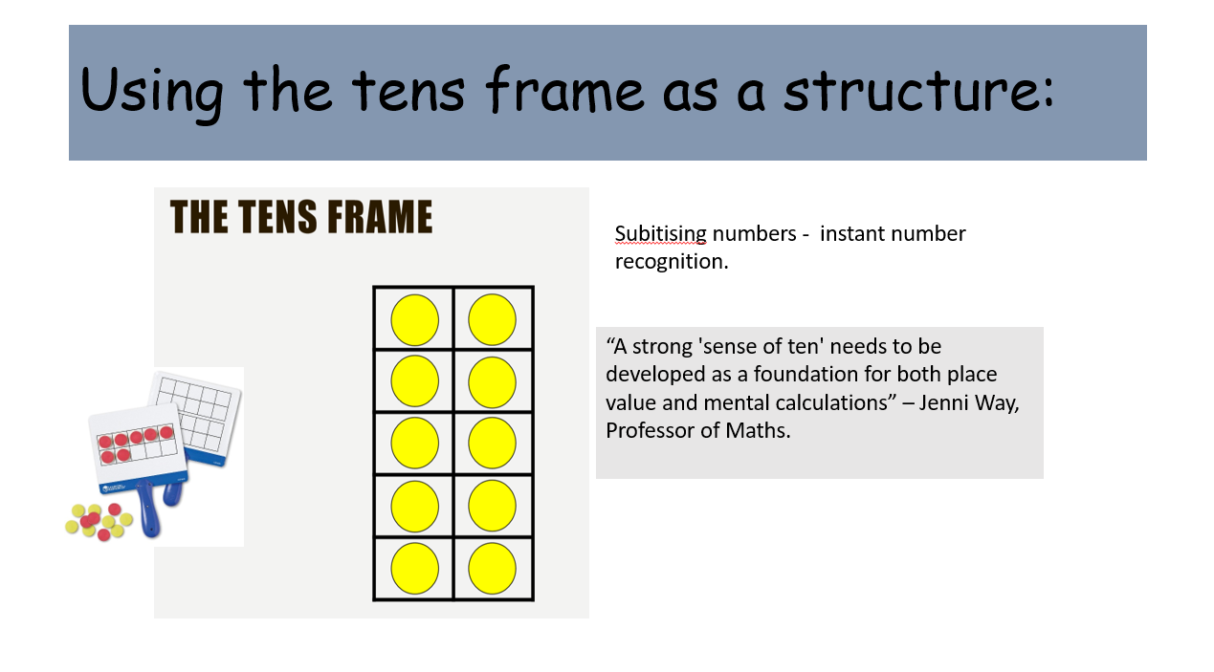

Slide 20
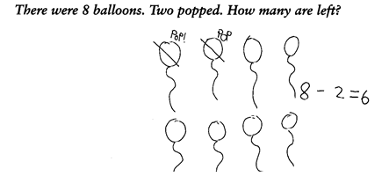
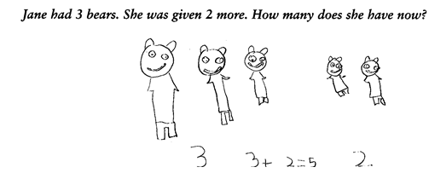
Early stages of + and -

Slide 21
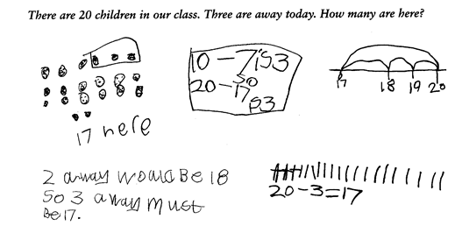
Same problem, different method

Slide 22

Problem solving
Explaining answers
Proving the answer
EXPLAIN
HOW ?
Why ?
pROVE

Slide 23
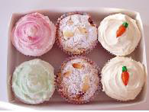
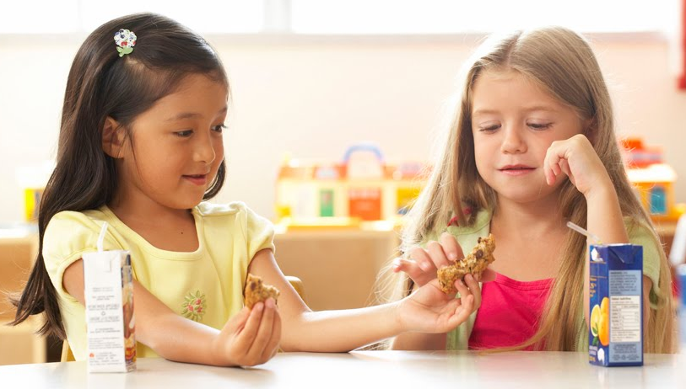
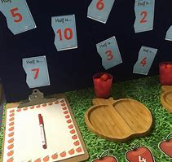
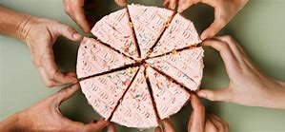
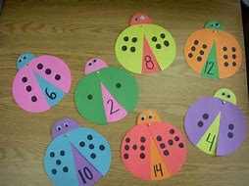
Solve problems, including doubling, halving and sharing.

Slide 24
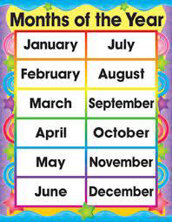

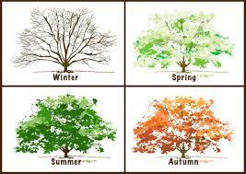
Measures Time
today
tomorrow
Yesterday

Slide 25
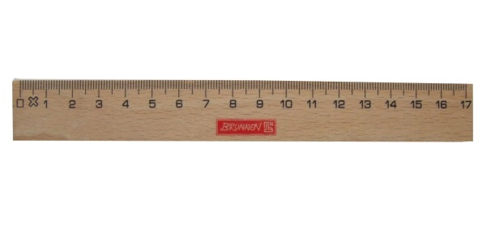
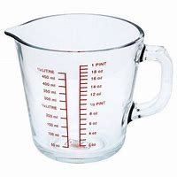
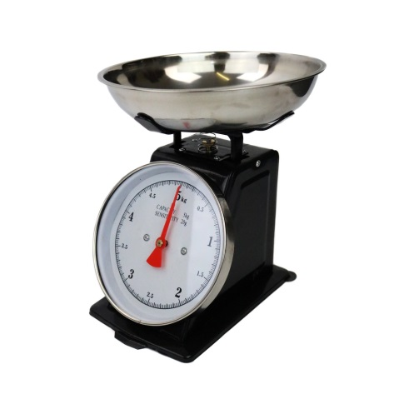
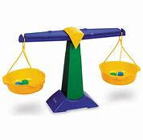

Measures
Length, width, height
Capacity
Weight

Slide 26

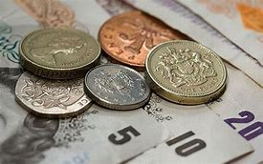
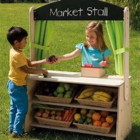

Money

Slide 27
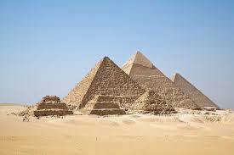





Shape

Slide 28
Making maths fun!
It is really important that children find maths fun! Children will learn much better if they are having fun.

Slide 29
Writing Numbers
A very tricky skill!
Although children are not required to form numbers in Reception class, we would encourage children that are ready to begin this.
It is an essential skill for year 1
Reception class teachers can offer guidance regarding your own child.

Slide 30
Helping at home

Slide 31
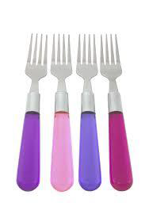
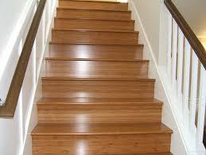
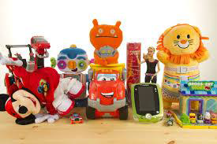
Counting

Slide 32

Looking for numbers

Slide 33
Sharing

Slide 34

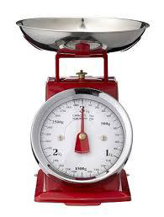
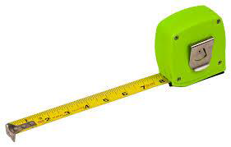
Measure

Slide 35
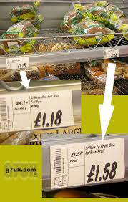

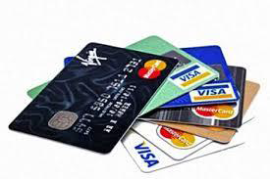
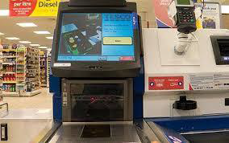
Money

Slide 36


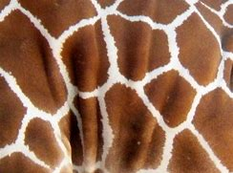
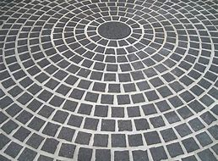



Shape

Slide 37
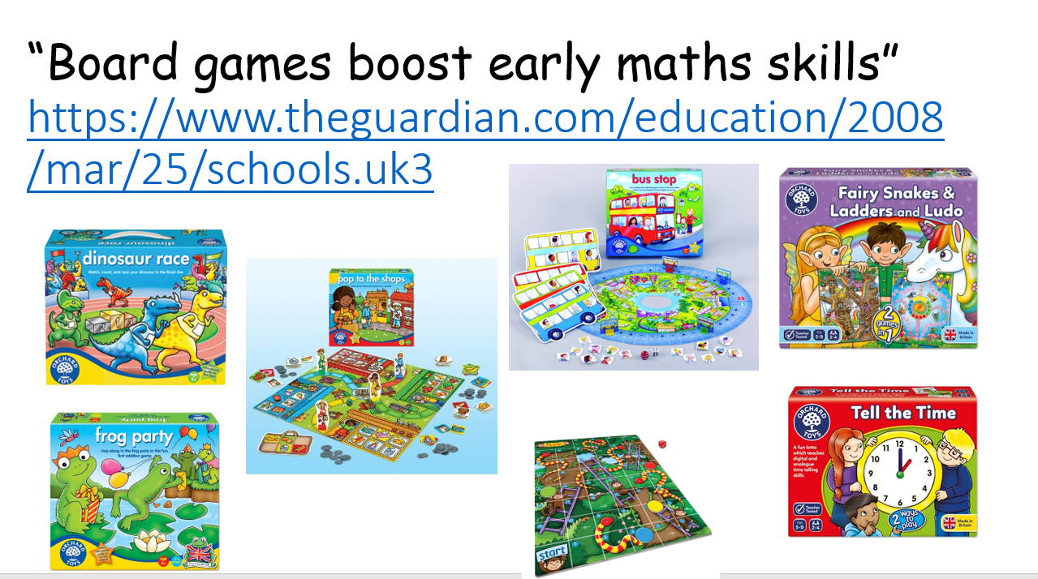

Slide 38
Websites
http://www.coolmath-games.com/
http://www.bbc.co.uk/cbeebies/games/theme/brainteasers/page/all
http://www.mathszone.co.uk
http://primarygamesarena.com/Year-1
http://www.ictgames.com/resources.html
https://www.topmarks.co.uk/maths-games/5-7-years/counting
http://www.crickweb.co.uk/Early-Years.html

Slide 39

Thank you for listening
Any questions ?

