Slide 1

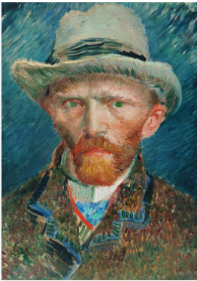
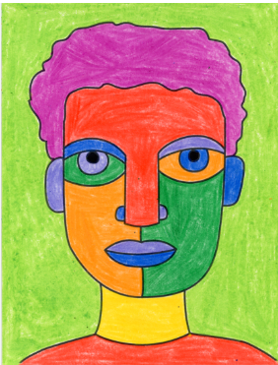
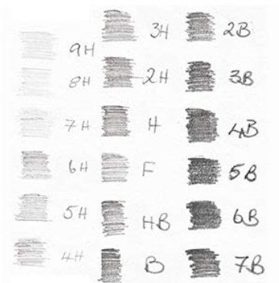
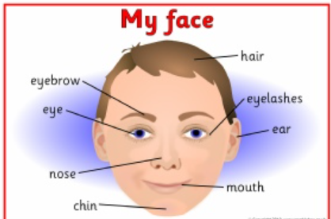
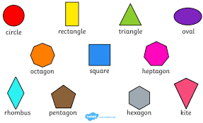
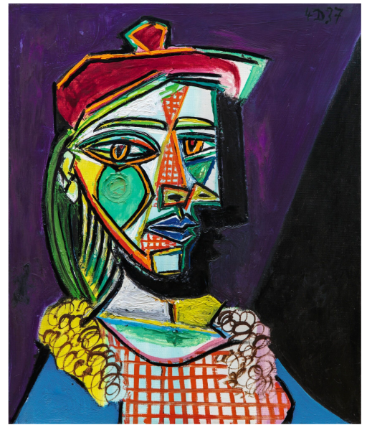
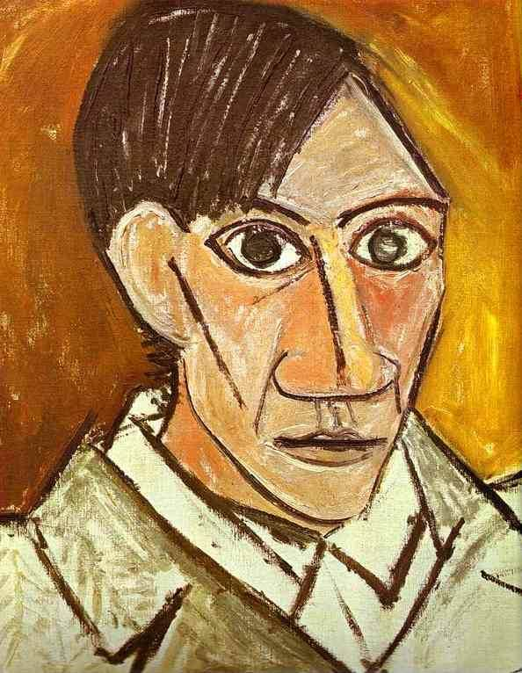
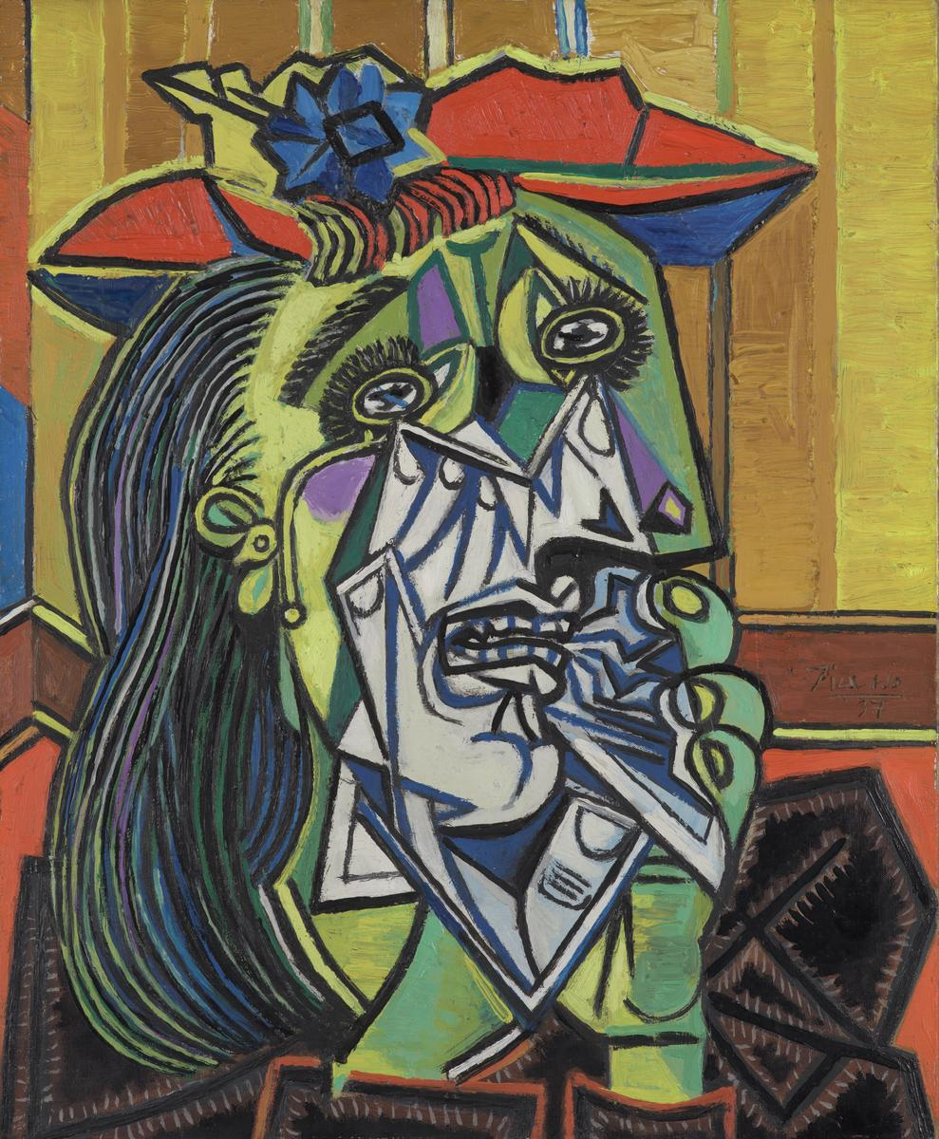
Year 1 – Self-portraits in the Style of Picasso
KNOWLEDGE ORGANISER
ESSENTIAL VOCABULARY
Self-portrait | When an artist draws a picture of themselves
Shape | The form or outline of someone or something
Oval | Something that is round and stretched out like an egg.
Position | A place where someone or something has been put.
Opposite | A different view or position from a specific point of view. E.g. up is opposite to down. Cold is opposite to hot.
Above | When something is over something else
Below | When something is under something else
lighter | when a colour has more light, not dark
Darker | When there is little or no light
Primary colour | Red, blue and yellow are the primary colours
Strokes | A mark made by a pencil, paintbrush in one direction
Grades | To arrange into groups or to sort.
What is a self-portrait? | What are different tones?
A self portrait is a when an artist draws a picture of themselves. They can choose to do it exactly how they look or they can make changes to their image. | When we are drawing we can use different types of pencils to make darker and lighter tones.
What different facial features can I draw?
What shapes can I use to draw facial features?
We can use different shapes to show facial features. A triangle could be used for a nose and a circle could be used as an eye.
Who was Picasso?
Pablo Ruiz Pixasso was a famous Spanish artist, who lived from 1881-1973. He made many great pieces of art using a style called Cubism. Cubism is when an artist paints something differently to how they see it, by painting or drawing features in different positions. Have a look at some of Picasso’s art work below
© Vocabulary Ninja Ltd 2021

