Slide 1
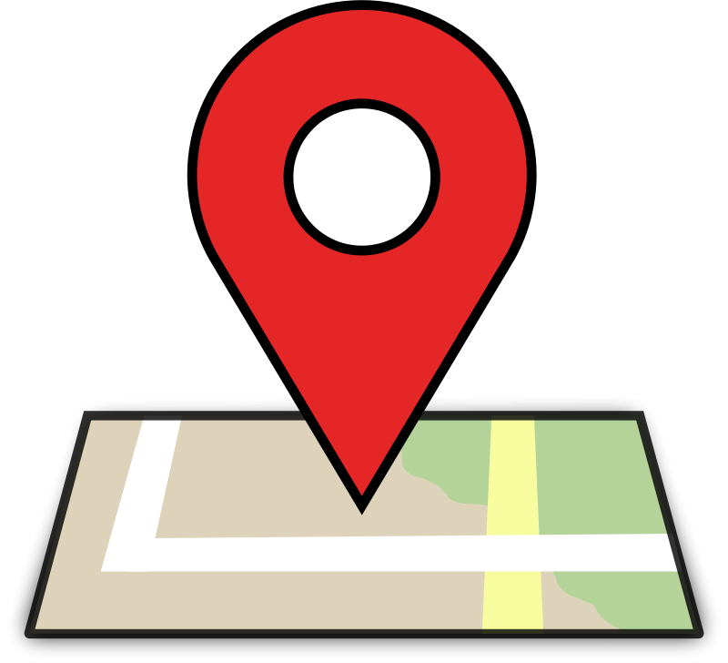
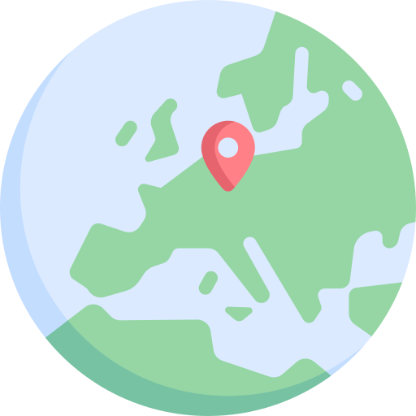
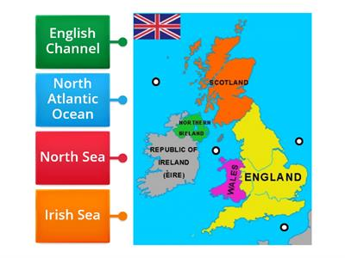
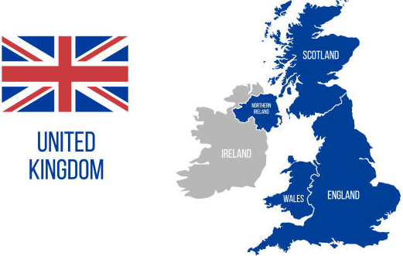
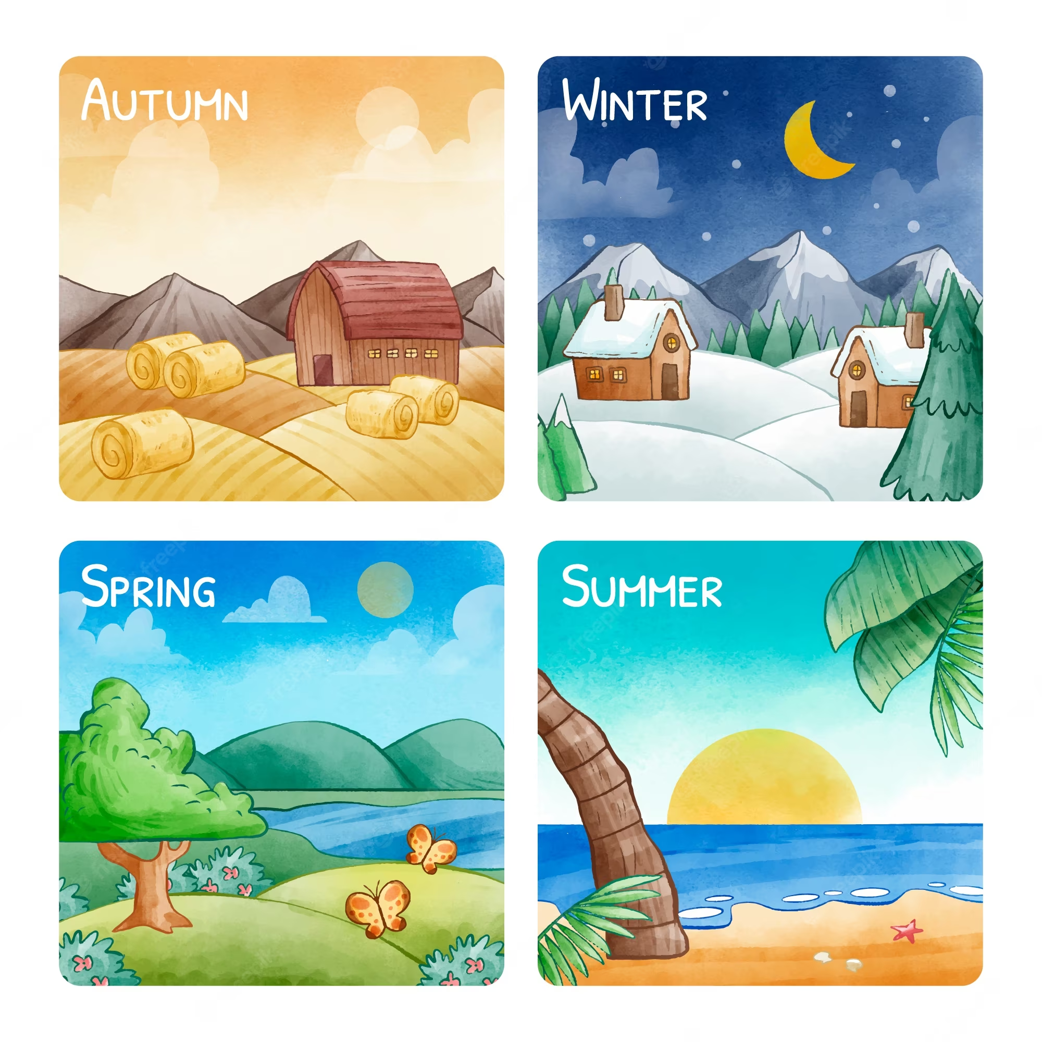
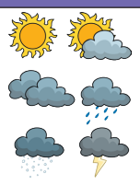
Y1 - Where in the World Are We?
KNOWLEDGE ORGANISER
Fun fact!
9 million people live in London!
What seas surround us?
What is the UK?
The UK is made up of 4 countries and each one has a capital city.
VOCABULARY
Location | A place or position.
County | Sections that some countries are divided into.
Capital | The city where the government of that country is located.
Local | All about particular place – a neighbourhood or town.
Key | A little box showing symbols for the information being shown.
Seas | A smaller area of water surrounding land – not an ocean!
Government | The group of people that are chosen to lead a country.
Seasons | One of the four parts of the year; spring, summer, autumn, and winter.
Climate | The usual weather conditions in a place.
Forecast | A prediction, or good guess, about what the weather will be like in the future.
Fun fact!
Some countries have extreme and dangerous weather!
England | London
Scotland | Edinburgh
Wales | Cardiff
Northern Ireland | Belfast
What is the weather like in our country?
The UK has four seasons. The weather changes when the seasons change. In general, the UK has warm summers and cold winters. The weather can change most days. One day it could be sunny and the next day it could rain.
Can I forecast the weather?
In a weather forecast, symbols are used to show what the weather will be like in a particular area. People check the weather forecast before they make plans for a day out. Computers are used to help make accurate weather forecasts.
How can the weather affect us?
Countries around the world have different climates. Countries near the equator have hotter climates and the Arctic and Antarctic have much colder climates. Climates can affect many things, such as which plants can grow. Many animals are specially adapted to the climate they live in
© Vocabulary Ninja Ltd 2021

