Slide 1
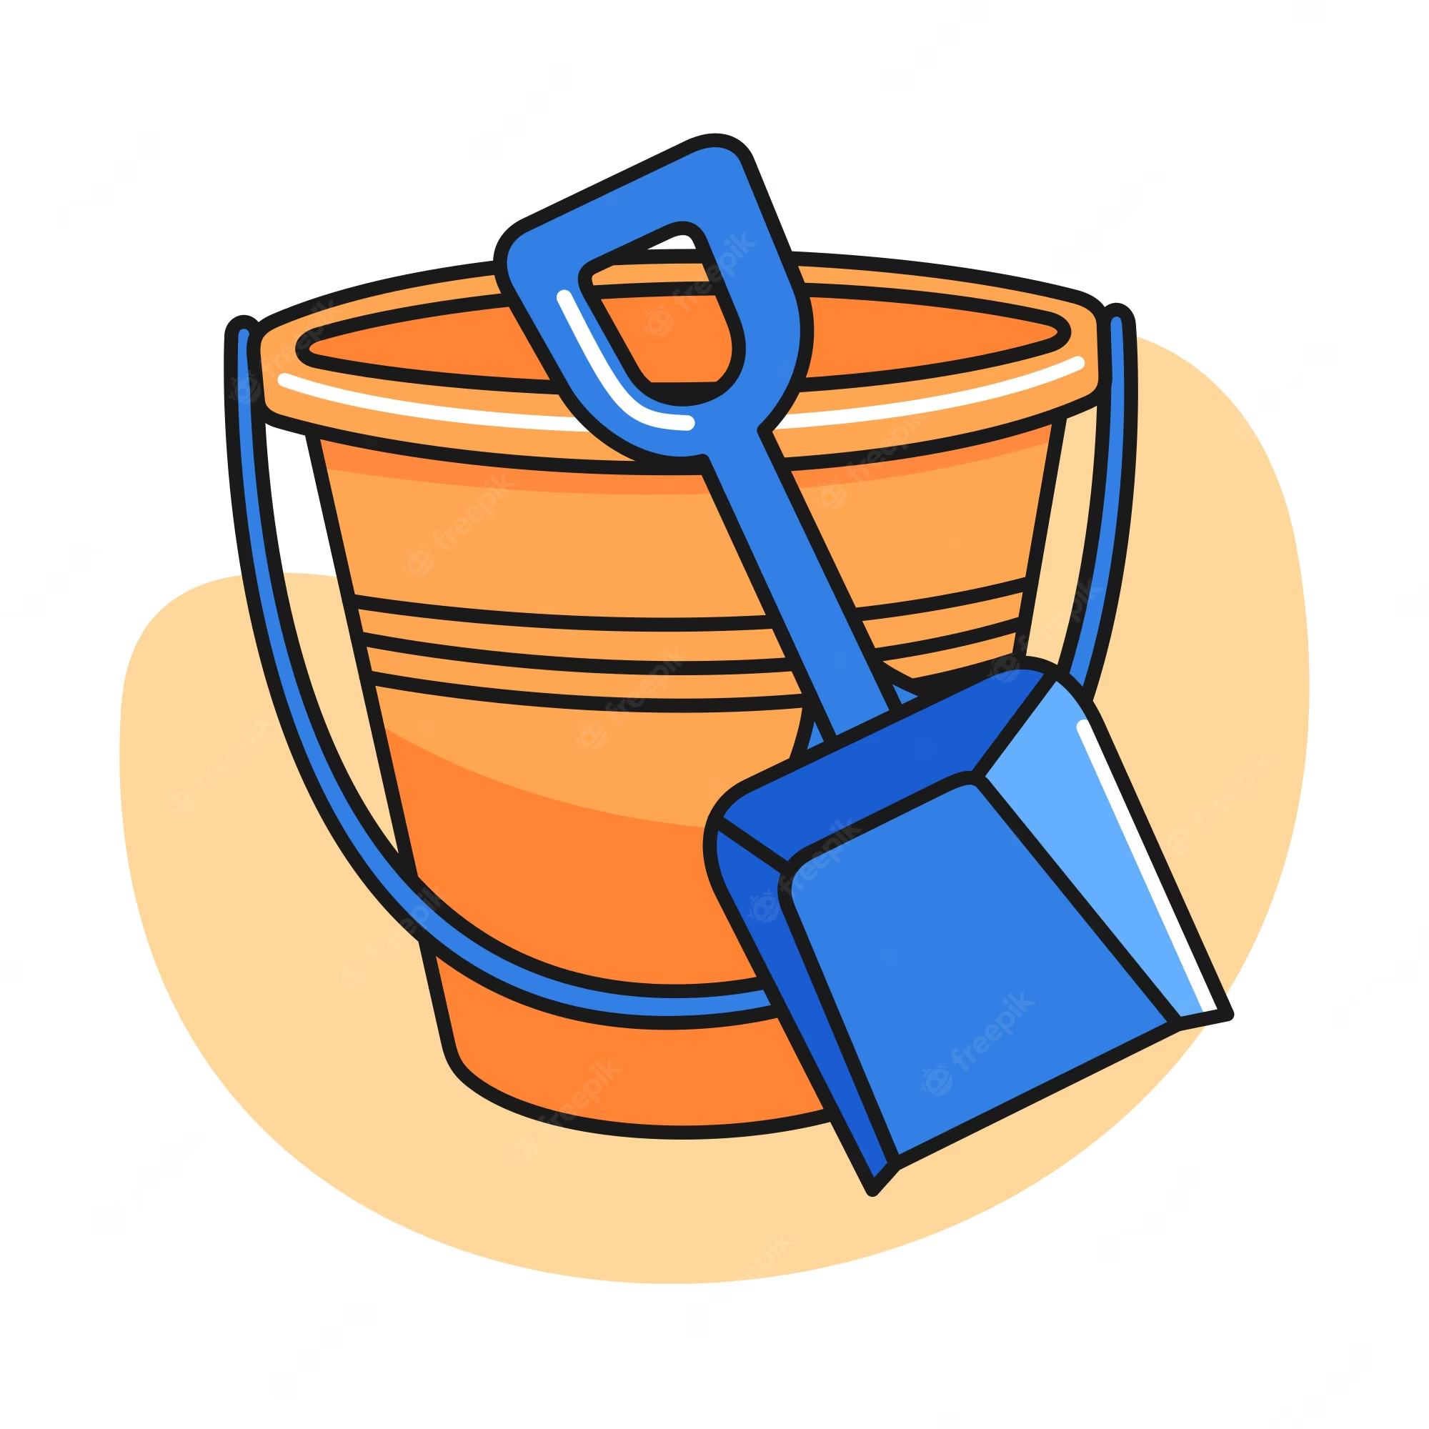
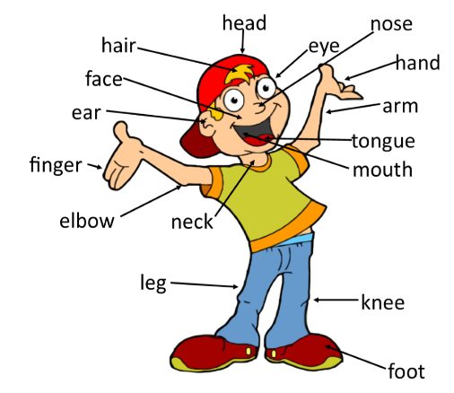
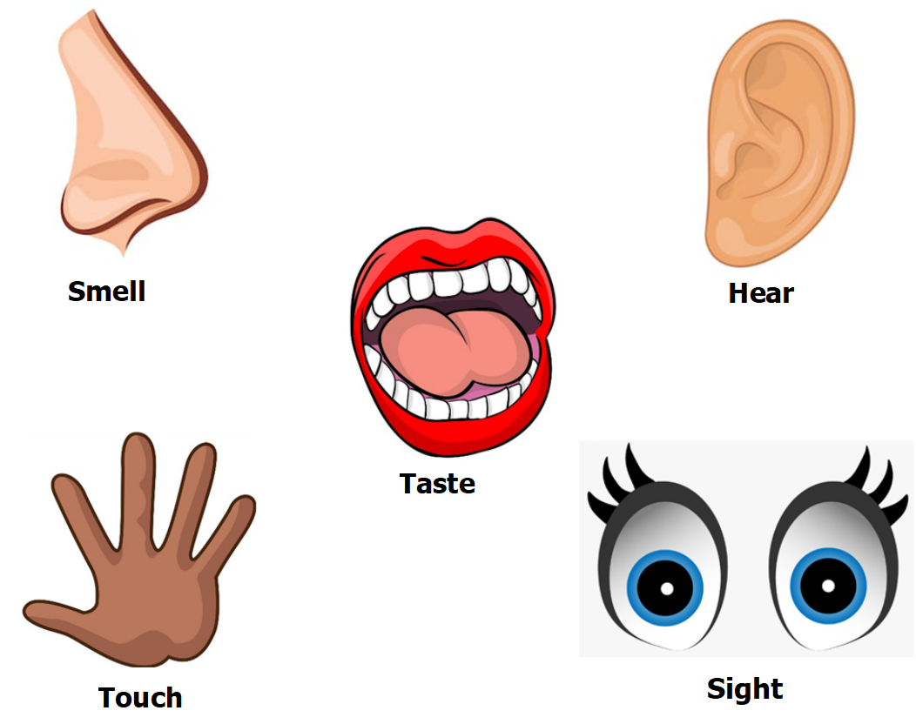
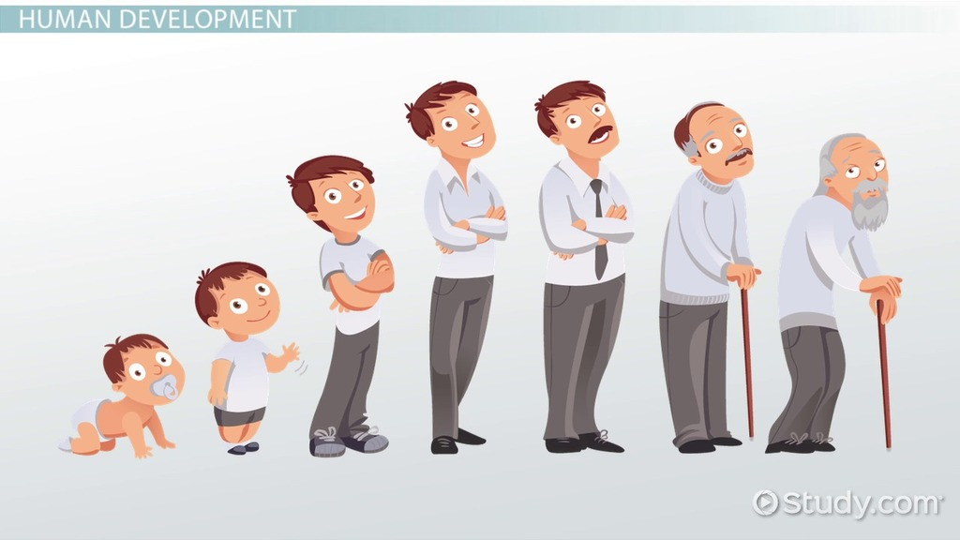
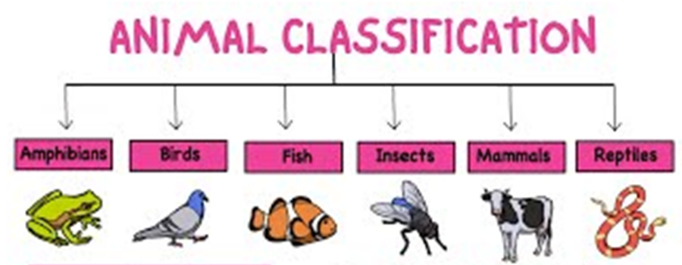
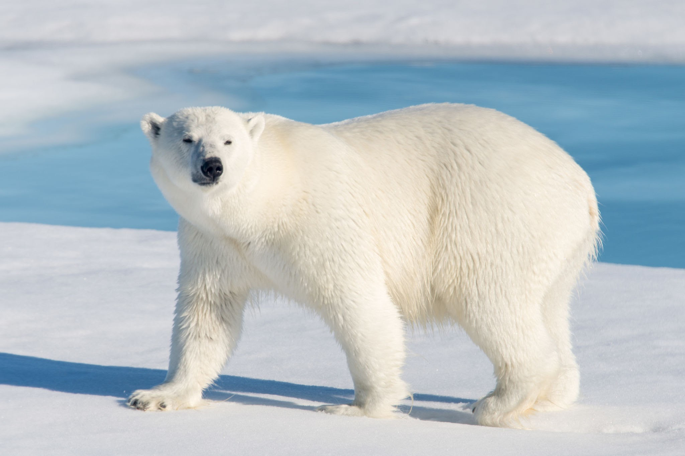
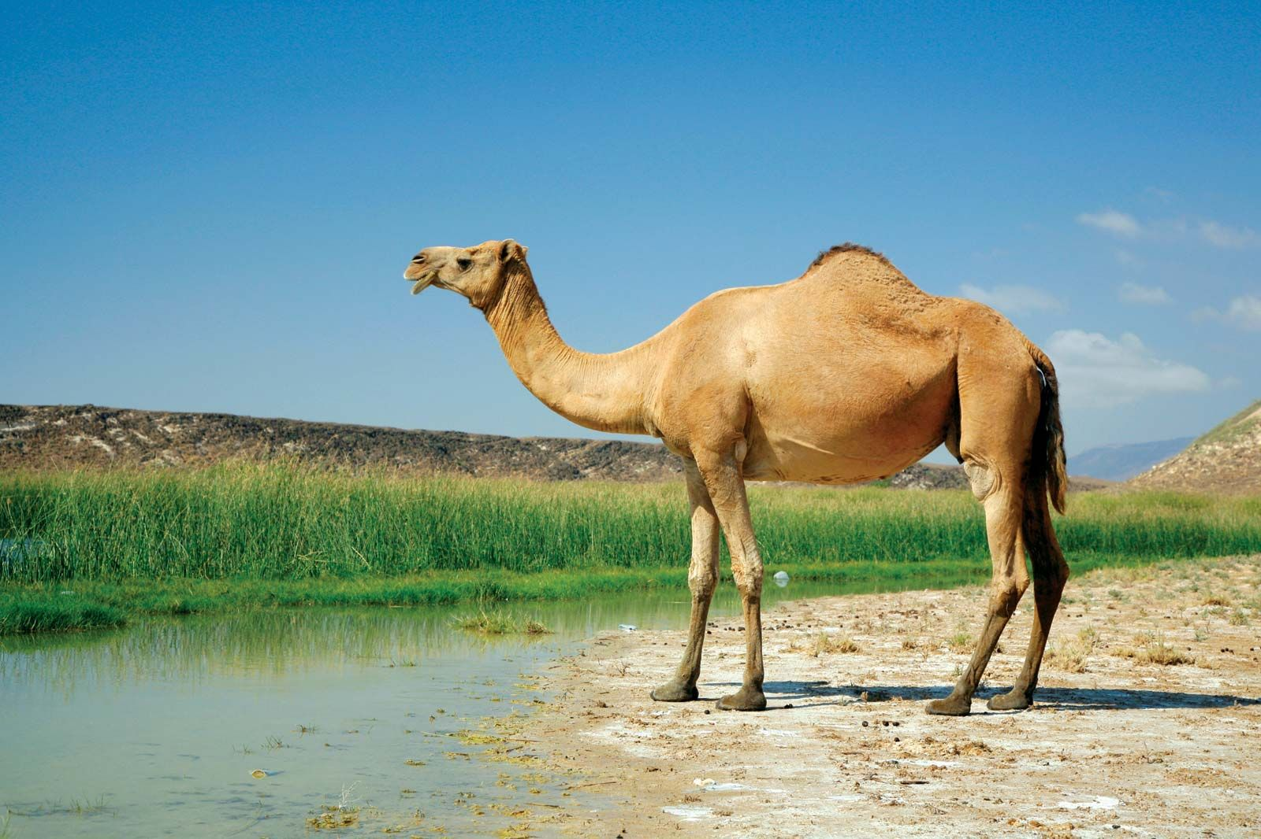
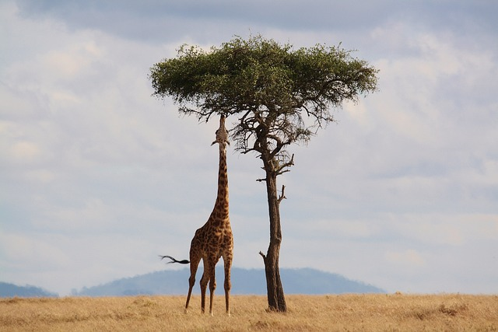
Year 1 – Science – Animals including humans
KNOWLEDGE ORGANISER
ESSENTIAL VOCABULARY
Herbivore | An animal that feeds on plants.
Carnivore | An animal that feeds on other animals.
Omnivore | An animal that feeds on both plants and other animals
Mammal | A warm blooded animal with a spine that has fur of hair.
Reptile | An animal with a spine that has dry scaly skin. The lay soft-shelled eggs.
Amphibians | Animals that can live both in the water and on the land.
Birds | A warm blooded animal with a spine that lays soft shelled eggs. They have feathers, a beak and wings.
Insects | a small arthropod animal that has six legs and generally one or two pairs of wings
Fish | Fish are animals that live in the water. They have a backbone and breathe using gils.
Habitat | A Natural home of a plant or animal.
Environment | Where an animal or living organism lives or operates.
What are our body parts? | What are our five senses?
How do humans change as they grow older?
As we grow older, we go through different stages as a human. Infancy – up to 1 year old Toddler – 1 – 5 years old Childhood – 3 – 11 years old Adolescence (teenager) – 12-18 years old Adulthood – 18 years and above.
What diet can an animal have?
Not all animals have the same diet. An animal will be one of the following: Carnivore – animals that eat other animals. Herbivores – animals that eat plants. Omnivores – animals that eat plants and other animals.
Do all animals live in the same place?
No! not all animals live in the same place. Different animals live in different habitats. Not every animal can live in the same environment. These animals have adapted well to their homes.
What are the different groups of animals?
© Vocabulary Ninja Ltd 2021

