Slide 1




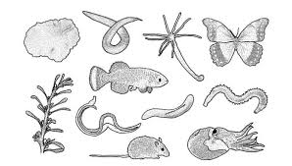
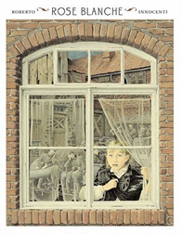
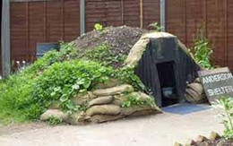
History
Maths
Children will look at numbers to ten million. They will then focus on addition, subtraction, multiplication and division.
Art
We will be looking back at World War 2. Our focus will be ‘What was it like to be evacuated?’
and ‘Why did WW2 start and how was Britain affected?’
Science
Living things and their habitat
Children will explore how we can classify all living things. They will learn about the scientist Carl Linnaeus.
Year 6
DT
We will build on our understanding of World
War 2 to explore structures that were used as air raid shelters. We will even make our own models of an air raid shelter.
English
Historical Stories
Rose Blanche
Children will be exploring the historical story Rose Blanche to write vivid setting descriptions of a small town in Germany occupied by Nazi soldiers in WW2.
Children about the features of biographies. This will lead us onto wriitng our own biography on the life of Anne Frank.
Autumn
1

Slide 2

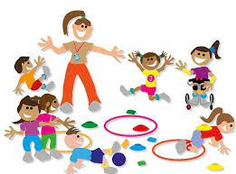
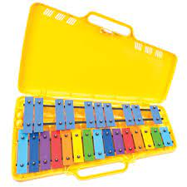




PE
ENRICHMENT
Music
Children will explore:
Net and Wall: Tennis
And
Invasion Games- Rugby
Children will be learning to play the glockenspiels to the song Happy by Pharrell Williams.
We will dissect a real lamb's heart to bring the circularity system to life.
Key Texts
Computing
The half term's topic is Communication and Collaboration. Children will explore how data is transferred over the internet.
RE
PSHE
The half term's unit is Being in my World. The children will set goals and see how their actions affect others.
Christianity – God
How do Christians mark the turning points on the journey of life?
French
The half term's topic is Actions. Children will explore basic vocabulary and apply this in simple sentences.

