Slide 1
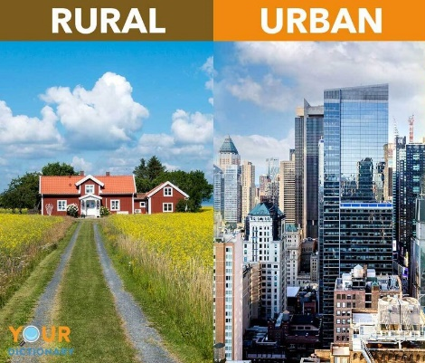


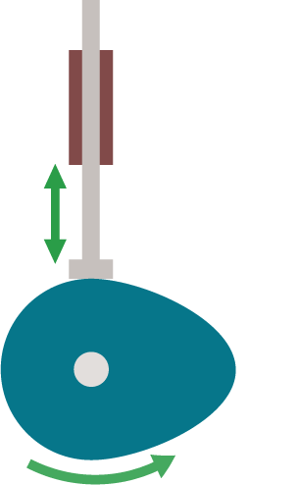
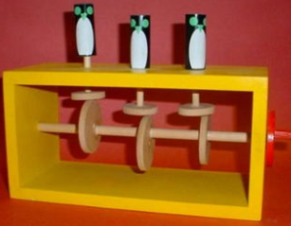
Maths
Children will begin the year developing their knowledge of place value, learning to write numbers to 1 million and round up to 6-digit numbers.
Children then move onto addition and subtraction, learning to add and subtract up to 6-digit numbers.
Geography
Land use
The children will learn look at the rural and urban land use within the UK. They will also create a sketch map based on the local area.
Science
Forces
The children will learn and investigate the effects of forces including: gravity, friction, air resistance and water resistance. They will apply their understanding of forces to explain how gears, levers and pulleys work.
Year 5
English
The Invention of Hugo Cabret
This half term the children will explore the novel The Invention of Hugo Cabret and write instructions on how to build an automaton
.
DT
Mechanisms: Automaton
Children will design, make and evaluate an Automaton using cams.
Autumn
1

Slide 2








Music
Children will be using the recorders to play and sing along to Livin’ on a Prayer by Bon Jovi.
PE
Children will develop their skills in dance and netball.
ENRICHMENT
Forest school
Class Novel
Computing
Computing systems and networks. Children will develop their understanding of computer systems and how information is transferred between systems and devices.
RE
Christianity: Why is it sometimes difficult to do the right thing?
PSHE
This half term’s topic is called Being Me in My World. Children will discover the rights and responsibilities we have to make school a fair place.
French
On Holiday: Children will be able to name more countries and holiday accommodation.

