Slide 1





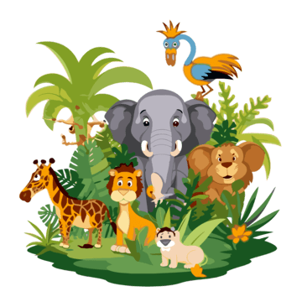
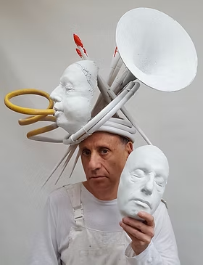

In Maths, we begin with place value, where we will be investigating numbers to 4 digits before moving on to formal methods for ​
addition and subtraction.
History
Exciting Egyptians!
Maths
In History, we will learn all about the Ancient Egyptians. We will look at the first 4 civilizations then move on to why the River Nile was so important. We will also learn about pharaohs and the process of mummification.
Science
Grouping and Classifying
In Science, we will be learning to groups and classify living things. We will be investigating vertebrates and invertebrates as well as flowering and non-flowering plants. We will then be conducting an observation experiment in our local area to observe changes over time.
Year 4
Art
Sculptures
English
Marcy and the Riddle of the Sphinx
In Art, we will look at sculptures. We will learn about the artist Phillip Haas and then explore Ancient Egyptian motifs and geometric patterns. We will then design and make Egyptian death masks using papier mâché
In English we will be reading Marcy and the Riddle of the Sphinx. We will be writing a setting description and we will write instructions on how to solve the Riddle of the Sphinx.
Autumn 1

Slide 2
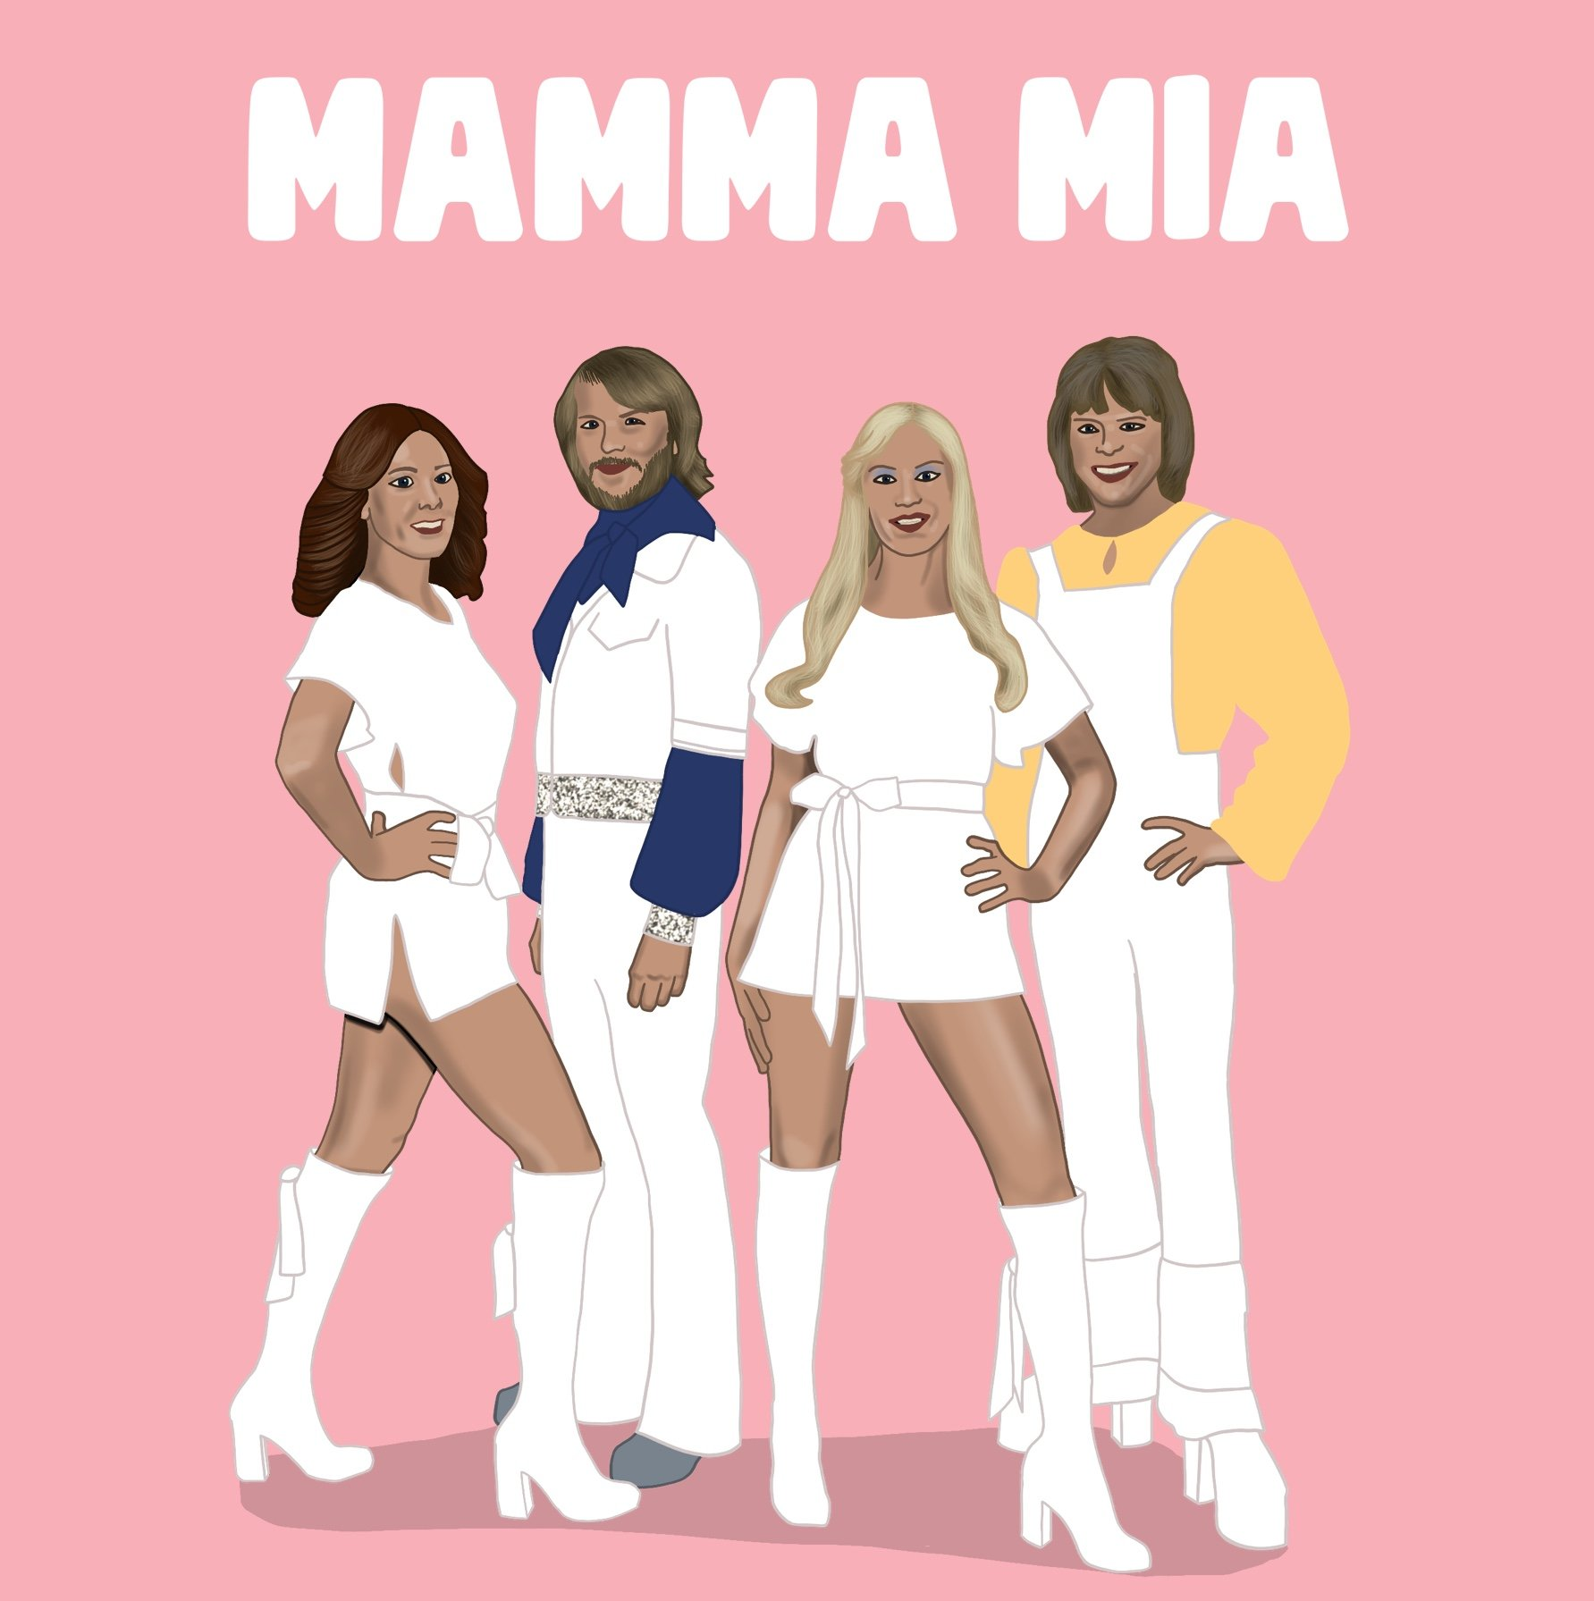







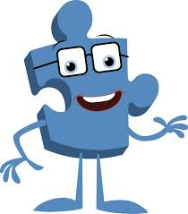
PE
ENRICHMENT
We will conducting some nature observations in our local environment and collecting data.
Music
In Music, we will be using our singing voices to learn the song 'Mamma Mia' by the Swedish band ABBA.
In PE, we will be developing our skill in rugby. We will also go swimming to learn important lifesaving skills.
[object File]
Class Novel
Computing
In Computing, we will look at computer networks and all the components that allow these to work efficiently. We will look at the world wide web and discuss how to stay safe online.
RE
In RE, we focusing on Christianity. We will learning about the Bible and how and why Christians use it.
PSHE
In PSHE, we will begin our unit: ‘Being Me in My World'. We will look at what rights we have as children and what responsibilities we might have and how we can be our best in our world.
French
In French, we will learning greetings and classroom vocabulary.

