Slide 1
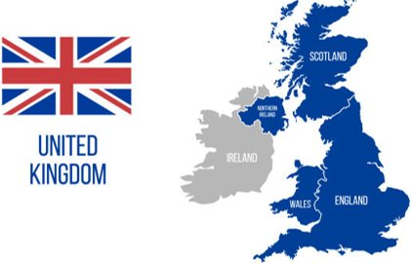




Maths
Place Value up to 1000.
Addition and Subtraction of numbers up to 1000.
Geography
Children will learn about the UK and its settlements. They will be looking at the features and functions. hamlets, villages, towns and cities.
Science
Children will learn the 5 groups that scientists use to classify foods and nutrients: Proteins, carbohydrates, fats and sugars, vitamins and minerals, and dairy. They will also learn the main parts of animal and human skeletons and their functions.
Year 3
D&T
Children will learn all about levers and linkages and how to use them to create a moving poster all about London. Children will learn how to use a fixed and loose pivot.
English
Children will develop their descriptive writing skills by planning, writing, and editing a setting description of an underground station based on Paddington.
Children will develop their persuasive writing skills by exploring the differences between city and village life and writing a balanced argument.
Autumn
1

Slide 2
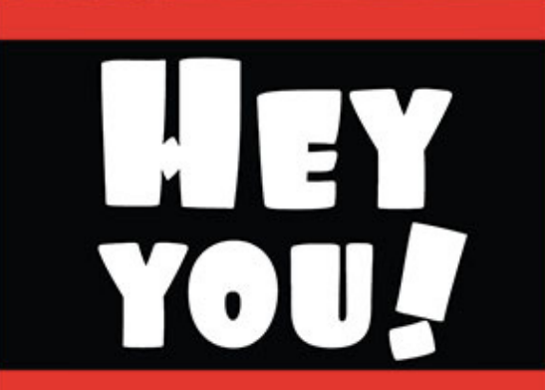
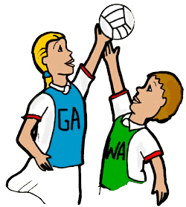






PE
Children will have the opportunity to explore throwing at a target, catching and dodging in games of netball and dodgeball. They will also explore gymnastics, including different rolls and jumps.
Music
Children will have the opportunity to make music using their voices. Through singing, children will practice, compose and improvise.
Key Texts
Computing
This term, children will be exploring the use of digital devices. They will learn about what a digital device is, how they are used, and how they are linked within a network.
RE
Children will learn about Christianity and God. They will learn about how and why people have served God.
PSHE
This term's topic is "Being Me in My World." Children will explore how their actions affect others and their place within the school community.
French
Children will learn how to greet others in French, as well as developing fundamental conversational techniques.

