Slide 1


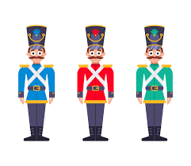
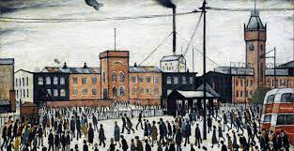
Maths
Children will begin with looking at Place Value in 2-digit numbers before moving on to
Addition and Subtraction.
History
We will explore the significant places in Burnley and analyse how they have developed over time. We will also look at life in the 19th Century, including schools and toys. We will visit Towneley Hall to enhance our learning.
Science
Animals and their need for survival. We find out what mammals need to survive looking with focus on birds, fish, amphibians and humans.
Year 2
Art
We will be experimenting with observational drawing.
We will explore the work of LS Lowry and the Boyle family.
English
In English we read the text: 'Way Home for Wolf'. We innovate our own stories using story maps.
invent a new character. Next, we then look at non-fiction texts and write an information page about animals living on the tundra.
Autumn
1

Slide 2


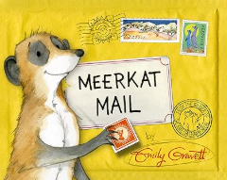



PE
Children will explore:
Fundamental movement skills including bouncing a ball
And
Playground games
Music
We will be learning to sing the song 'Hands, Feet, Heart' by Joanna Mangona.
Key Texts
Computing -
INFORMATION TECHNOLOGY.
Children learn about IT in their classrooms, homes and the world. We learn about the benefits of IT, how it can improve our world and how to keep safe online.
RE
In RE, we are exploring Christianity, looking at what Christians believe about God. This focuses on how Christians believe the world was created.
LIFE SKILLS-
BEING ME IN MY WORLD
Children learn about positive and negative behaviour and how there are rewards and consequences.
We discover how we can co-operate as a
team.
Daily RWI Phonics

