Slide 1
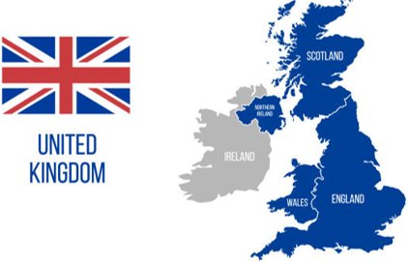



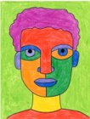
Maths
Number Place Value within 10.
Addition and Subtraction within 10
Geography
Children will explore the world they live in, starting with an understanding of the United Kingdom and it’s four countries and the seas that surround it. Children will explore the UK’s capital cities and weather patterns. They will have opportunities to observe and record the weather, presenting their own weather forecasts.
Science
Children will learn about five of the groups that scientists use to classify animals: mammals, fish, birds, reptiles and amphibians. They will learn to identify the group an animal belongs to by its features and will classify animals according to their group. They will also learn about the different diets animals eat. Children will learn about the parts of the human body and have the opportunity to explore the five senses through a simple investigation.
Year 1
Art
The children will focus on drawing and painting self-portraits. They will be using pencils and paints to create pictures in the style of Pablo Picasso.
English
Children will be focussing on Capital letters, full stops and finger spaces as we write sentences based on our book The Three Little Pigs.
Autumn
1

Slide 2
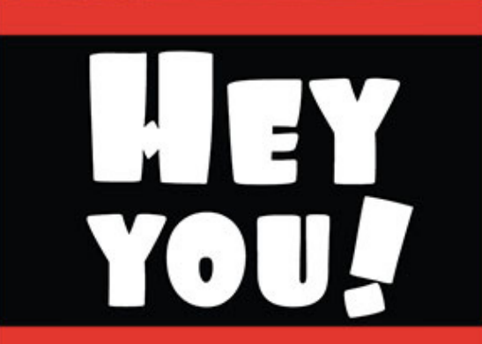



ENRICHMENT
We will go on a senses walk and have a practical senses afternoon discovering our senses.
Music
In this unit of work the children will listen and appraise a variety of Hip Hop and reggae songs. All the learning in the first unit will focus around the song ‘Hey You!’. Children will sing songs and use the tune ‘Hey You!’ to improvise and compose their own versions. They will also learn the songs ‘Rhythm in the way we walk’ and ‘The Banana Rap’ and learn about pitch.
PE
The children will be practicing Rolling a ball and completing Baseline assessments of the fundamental skills.
Key Texts
Computing
Information Technology
In this unit the children will be looking at the Technology around us and how we use it. They will be using laptops to develop their mouse and keyboard skills.
PSHE
BEING ME IN MY WORLD.
Children will learn about being happy and safe in school. They will be able to say how they help keep our classroom a safe place to be.
RE
Why do Christians say that God is a ‘Father’?
In RE children will learn about the importance of God to Christians. They will look at the different symbols in Christianity and the meaning of them The children will listen to different stories from the bible to understand that Christians believe in God the Father.
Daily RWI Phonics

