Slide 1






Geography
Maths
Burnley v Tuscany
This term we are learning about our local area. We will be looking at the natural and man made features in our area and comparing this with Tuscany.
This term we are starting our topic on multiplication and division. Pupils will work at their own pace through the unit. We will start by focussing on recognising and making equal groups.
Science
Skeletons
This term we are learning about skeletons and the role they play in supporting the body. We will start by learning about human skeletons and investigate how our bones, joints and muscles work together.
Swans
Art
English
Traditional Tales
Printing
This term we are learning about Printing. We will be learning how to use a range of different printing techniques to create our own artwork.
This term we are reading Goldilocks and the Three Bears and Hansel and Gretel. We will be working towards writing a setting description from the story.
Autumn
1

Slide 2
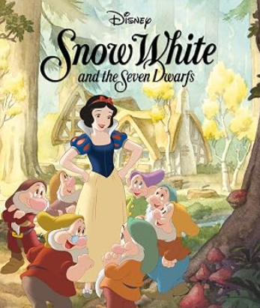





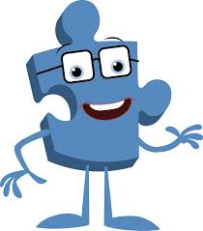
PE
ENRICHMENT
Music
Hands, Feet, Heart
This term we are listening to a range of South African music. We will learn to sing the song 'hands, feet, heart' whilst developing our knowledge of playing to a beat.
Net and Wall
This term we are learning about how to throw a ball on a target, and how to hit a ball with a bat.
Our curriculum is enriched by our THRIVE approach to learning.
Class Novel:
Computing
IT
This term we are learning about IT. We are learning what IT is and how we can use it.
RE
Christianity
This term we are learning about Christianity. We are going to explore the key values of Christianity, including leadership.
PSHE
Being Me in My World
This term we are learning about how important it is to be kind and respectful. We will be creating our own class rules.
THRIVE
We are developing our turn taking skills and learning to work with a partner towards a common goal.

