Slide 1


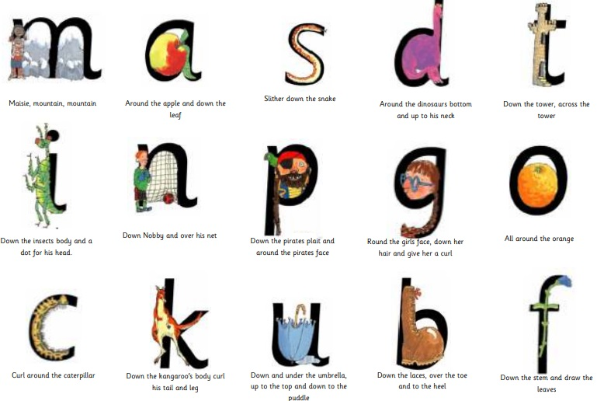


Our topic this half term is ‘Superheroes.’ We will be thinking about what special super powers we might have and investigating our super senses. We will talk about caring for others. We will be answering the learning challenge questions – Are we all the same? What do I look like? What do my body parts do? When is my birthday? Who is in my superhero family? We might even have a superhero visit!!
Daily RWI Phonics
Reception
Woodlands
We will go to the woodlands to investigate the environment around us including the woodland area on campus and our local environment.
Read, Write Inc – every morning we have fun with Fred Frog practising and learning new sounds and words in the Read Write Inc sessions. With our Super Sonic listening skills we will be - Tuning in to sounds, listening and remembering sounds and talking about sounds. Our superheroes will be taught to say and recognise initial letters sounds of words.
In our Magy something is.
In our Magic Maths time children will be encouraged to quantify sets of objects by subitising, rather than counting. When subitising, children can say how many there are in a small group of objects by ‘just seeing’ and knowing straightaway without needing to count.
Autumn 1

Slide 2
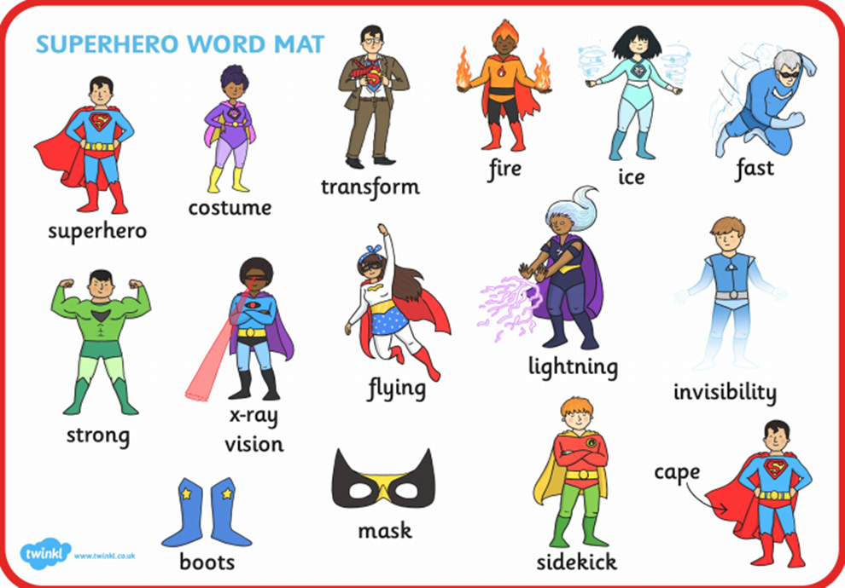
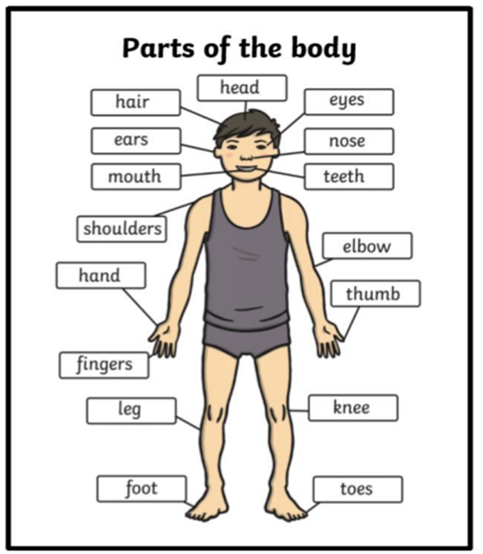

.
Our Super Bodies
In P.E. We will be learning to use space effectively and develop games skills such as catching and throwing. We will continue to exercise in our ‘Wake up and Walk’ sessions and see what happens to our bodies.
We will develop our gross motor skills with large movements which will help our muscle strength and endurance, coordination, balance, body awareness and shifting our weight. We will strengthen our hands and fingers with different activities to get ready to write, paint and manipulate objects.
Key Words
Subitise count quantity objects big small bam boom crash pow wow zap fast strong super rescue transform power disguise
Activities to try
Talk about what you see with your super vision on the way to school.
How many steps does it take to go up the stairs?
What numbers can you see on the doors?
Try different forms of movement, e.g. hop, skip, jump, run, walk
Ways to Support Children at Home…
Talk to your child about what they have learnt.
Can you help your child to find out more, you could search online or take them to the library?
Help your child with their home learning – Talk homework.
Listen to your child read every day and give
them lots of praise!
ENRICHMENT
We will all be paired up with a Year 6 buddy who will help us throughout our first year at Barden!

