Slide 1


Maths
The children will be exploring objects through matching, identifying favourite objects, sorting into groups, exploring colour and looking at similarities and differences.
Continuous Provision
This half term continuous provision will focus on forming relationships, sharing and turn taking as well as exploring likes and dislikes.
Science
The children will be learning to identify different parts of their body through stories and songs.
Herons
Art
This half term we will be looking at creating self-portraits using paint, pencils and through collage.
Communication, Interaction and Shared Stories.
The children will be exploring themselves through stories with a focus on knowing ourselves, understanding who is in our family, building relationships within the classroom and understanding feelings.
Autumn
1

Slide 2
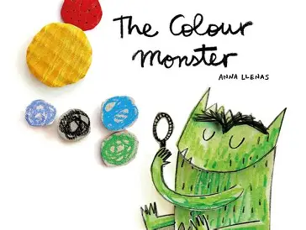



Music
The children will be exploring musical instruments and learning how to listen to and create the different sounds they make.
PE
The children will be working on fundamental movement skills such as balancing, jumping and moving around obstacles.
Key Texts
LIFE SKILLS-
BEING ME IN MY WORLD
This half term will be focusing on school life and feelings.
RE
In RE, we are exploring Christianity, looking at what Christians believe about God and recognising symbols relating to Christianity.
Daily RWI Phonics

