Slide 1






Maths
History
Children will explore place value within 10, taught in a practical way at their personal level of learning.
Celebrate Good Times – All About Me
Children will be learning about the 'past' through stories, role play and sensory exploration of historical resources. Children will explore their own past, through baby pictures.
Science
Physical processes (forces) -
floating and sinking
Children will learn about floating and sinking. Children will be exploring which materials float and which sink with the aim of making their own boat.
Cygnets
Art
Helping Hands - drawing
English
Children will continue learning speedy sounds through multi-sensory lessons at their own pace. Children will explore a range of books to promote a love for reading.
Children will be mark making using a range of materials. We will be focusing on 'line' to begin with and then starting to explore the work of Picasso.
Autumn
1

Slide 2

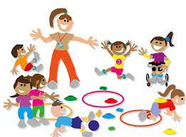





PE
ENRICHMENT
Music
Children will explore the fundamental movement skills, focusing on static balances. Children will also explore moving in a space and following instructions.
Our curriculum is enriched by our THRIVE approach to learning.
Exploring sounds, instruments and graphic scores.
Children will explore a range of instruments and the sounds that they make. Children will begin to use words, signs or symbols to describe what they can hear.
Class Novel:
Computing
Computer Science
Children will explore 'programming' through learning how to use a range of technology. Children will also explore programming in the world around them, e.g., following instructions.
RE
PSHE
Christianity
Children will learn about stories from the Bible which will be taught through sensory stories.
Being Me in My World
Children will explore how we are all part of our class and school community. Children will continue to develop their play and sharing skills.
THRIVE
We are developing our turn taking skills and sharing skills through play.

