Slide 1
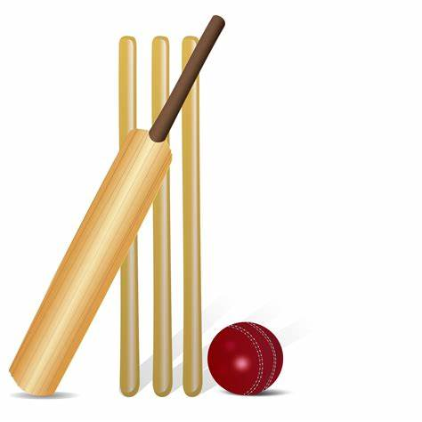
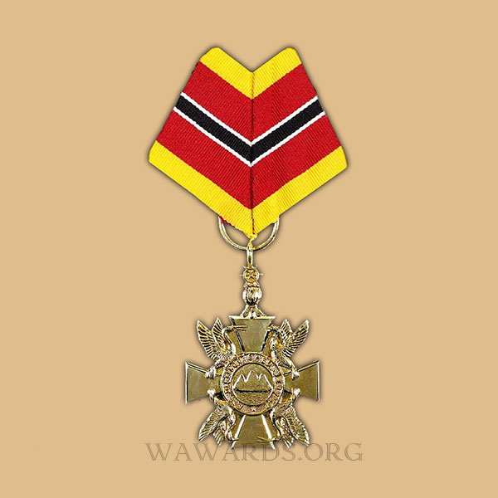

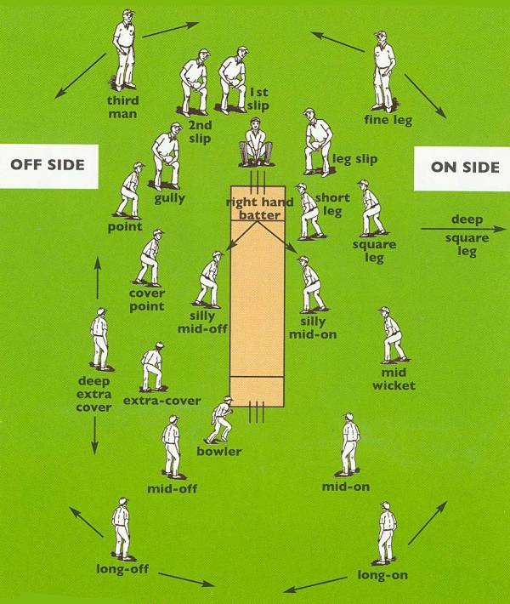
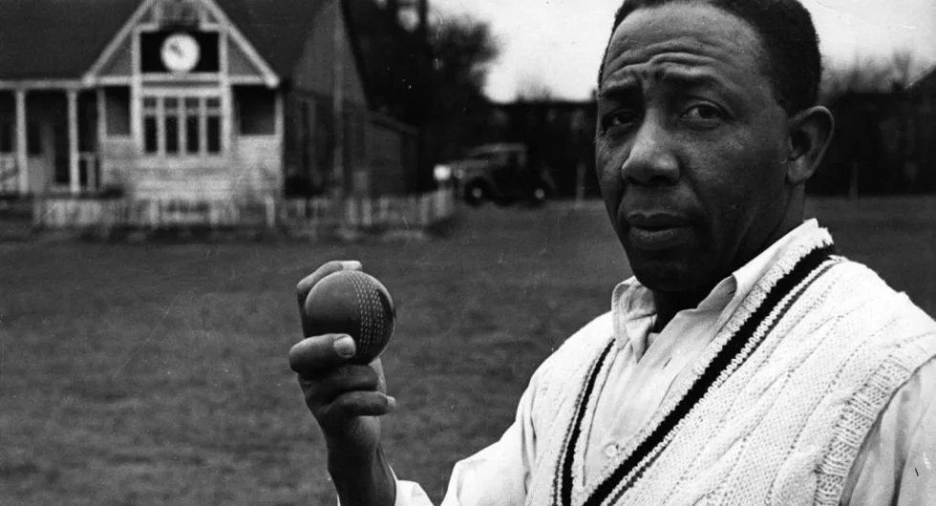
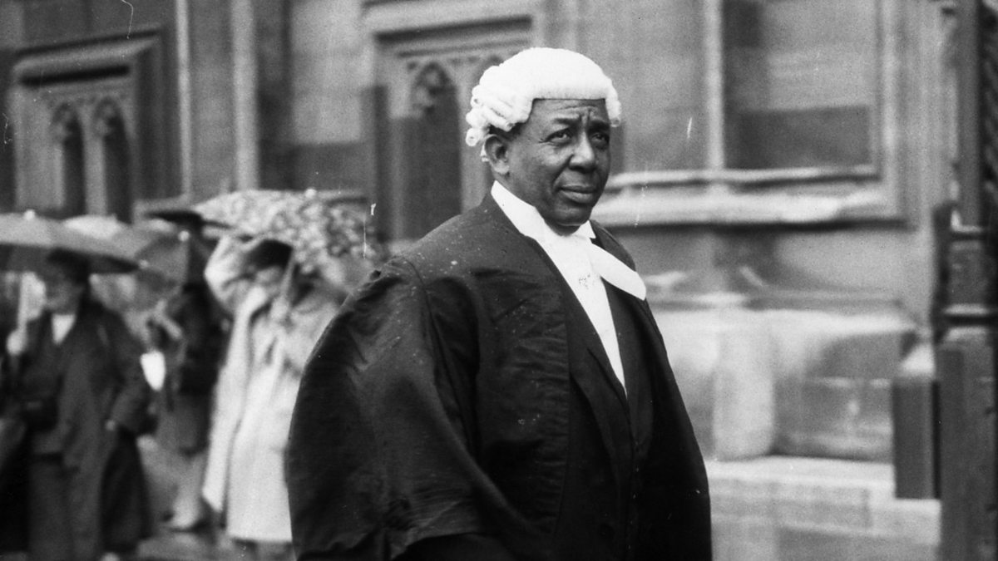
Cracking cricketer!
KNOWLEDGE ORGANISER
ESSENTIAL VOCABULARY
Racism | When you are not accepting of other people because of their skin colour, where they are from or what they believe
Migration | When people move to another country for work or better living conditions
Cricket | A sport involving striking and fielding that has been played for since 1797 in England
Bowler | A position in cricket where somebody is bowling a ball at the batters wickets
Batter | A position in cricket where the batsman protects the wickets by batting the ball away
Fielder | A position in cricket where somebody collects the ball the batsman has hit
Trinidad | A country that helps to make the West Indies
Nelson | A town in East Lancashire that is just north of Burnley
Medal | A prize or award given to somebody for an achievement
Distinguished | This means somebody has achieved a lot and is respected because of it
Outstanding | Somebody who has achieved something great.
Significant | This is another word for important
How do people become significant?
People become significant because of their important work that helps other people. Marcus Rashord received an MBE from Prince William for his work helping to provide children with free school meals during the coronavirus pandemic,
What is the Trinity Cross?
The Trinity Cross was an award given to distinguished people from Trinidad for their services. Learie was awarded this after his death in 1971.
Who was Learie Constantine?
Learie Constantine was born in Trinidad. He was a fantastic cricketer and was known to be one of the best fielders of all time. He came to England to play cricket from the West Indies. After his playing career he trained to become a laywer and became the first black person in history to join the Houses of Lords. He fought against racism throughout his career and ensured people were treated fairly regardless of their skin colour or where they were from.
What positions are there in cricket?
The three main positions in cricket are: Batter Bowler Fielder
Where did Learie Constantine play cricket?
Learie played cricket in the Lancashire leagues during the 1920’s and the 1930’s He played for Nelson for 9 years and was the first black player to do so. During his time in Lancashire, he was the highest paid sportsman in the country.
© Vocabulary Ninja Ltd 2021

