Slide 1
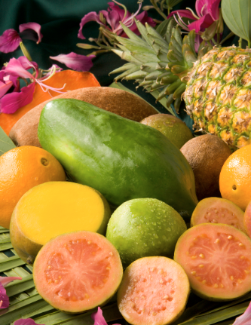
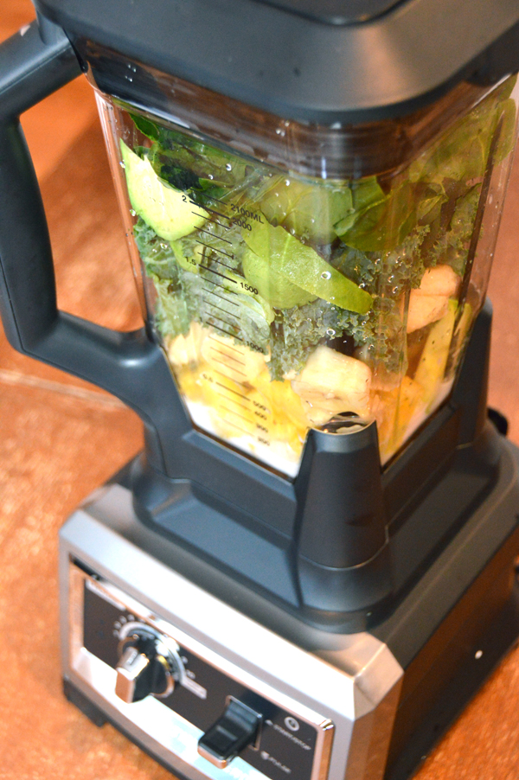
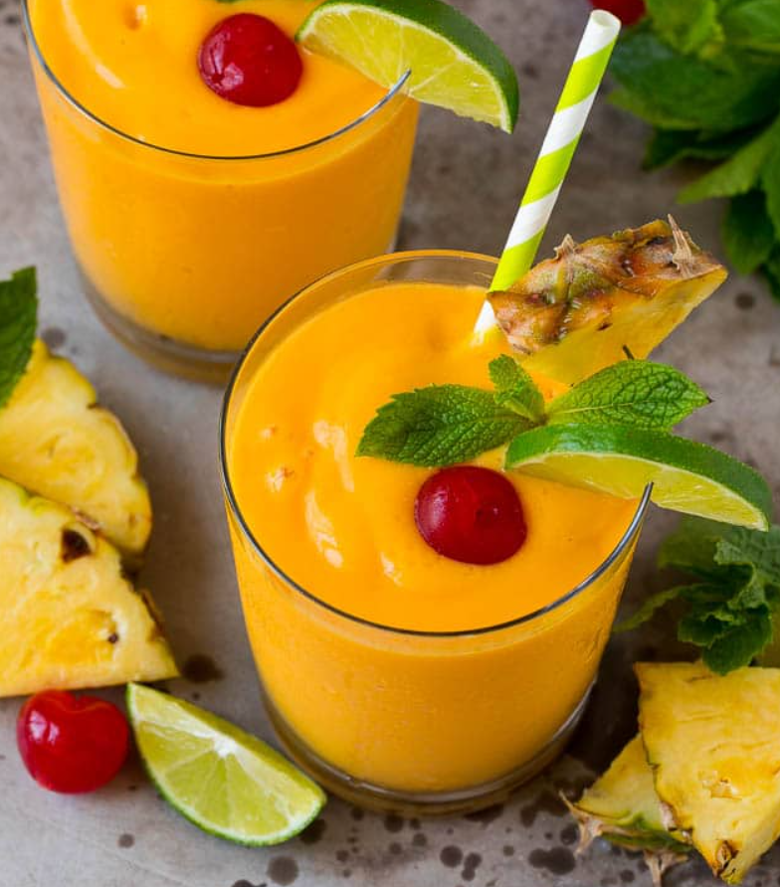
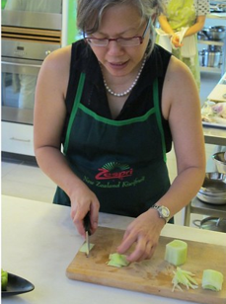
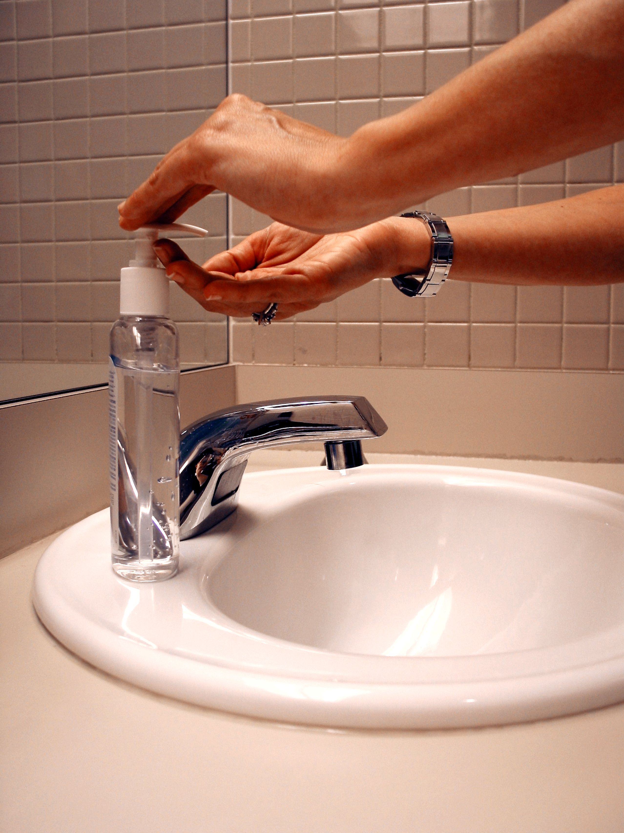
Design and Technology Knowledge Organiser Year 1
Cooking and Nutrition – Caribbean Fruit Smoothie.
ESSENTIAL VOCABULARY
Juicy | Something that has a lot of juice, succulent
Crunchy​ | Making a crunching sound when chewed or pressed.
Sticky​ | A sticky substance is soft, or thick and liquid, and can stick to other things.
Smooth | Free of roughness, stubble, or other imperfections that you can feel with your hands.
Sour​ | Something that has a tangy or sharp flavour, like a lemon.
Crisp​ | Something that is hard but easily breakable and brittle.
Flesh​ | The part of the fruit around the seed is juicy and soft.
Skin​ | The skin of a fruit may be thin, tough, or hard. Its insides are often sweet and juicy.
Seed​ | Seeds are the small parts produced by plants from which new plants grow.
Pip​ | A small fruit seed.
Slicing​ | The act of cutting something into parts.
Peeling​ | To remove the skin of fruit and vegetables:
Cutting​ | To pierce, slice, or open with a sharp tool such as a knife
Squeezing | To press something firmly, especially from all sides in order to change its shape, reduce its size, or remove liquid from it.
Healthy | Keeping healthy means doing things that are good for your body - things like eating nutritious foods, exercising, brushing your teeth and getting enough sleep.
Diet​ | The sum of food that is eaten by a person.
Ingredients​ | The things that are used to make something.
Design | To design is to create, sketch out, or invent something.
Plan | The way that you are going to do something, thought of before you do it.
Evaluate | To judge how good or bad something is.
Purpose | The reason for which something exists or is done, made, used.
Overview
Children will… Know what healthy food is. ​ Know what fruit and vegetables are and know the names and tastes of a range of different ones. ​ Know how to safely and hygienically handle and prepare fruits and vegetables.​ Know a variety of methods for preparing food e.g. cutting, grating, slicing, peeling. ​ Know how to assemble and present food for others to eat.​
Carribean Fruit Smoothie
Technical Knowledge and Skills Making
Evaluating
What fruit have you used? Do they taste nice together? What went well with your smoothie? Would you improve anything next time?
I can cut food safely.​
I can wash my hands and make sure that surfaces are clean.​
21

