Slide 1

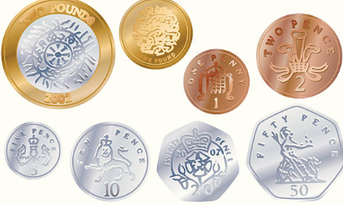

Maths
This half term we will be looking at money and starting to look at multiplication and division.
History
The History of Space Travel
We will learn about Neil Armstrong and how he contributed to international achievement. We will also look at how technology has improved our knowledge of space travel.
Science
Materials
The children will be looking at a range of materials. The children will be able to identify and classify different materials. They will be able to perform simple tests.
Year 2
DT
This half term we will explore Mechanisms. We are looking at Wheels and Axles and will explore how to join different parts. We will investigate the best material to use for axles out of plastic tubing and cardboard triangles.
English
In English, we will be writing our own instructions 'How to look after a sunflower'. We even plant our own seeds and text out our instructions.
Spring 1

Slide 2



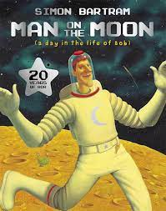
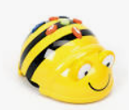


ENRICHMENT
Astronaut training
Music
We will be learning to sing the song I want to play in the band.
We will also be looking at composing our own pieces of music.
PE
Children will explore:
Dance
Games –
piggy in the middle
Key Texts
Computing
Programming
We will be investigating instructions and following them. Then we will use the Bee Bots to test our programs and debug any problems we find.
LIFE SKILLS
Dreams and Goals
We are looking at how we can stay motivated and how we can continue to keep trying when things are difficult.
We will then look at how we can achieve our goals.
RE
This half term, we are exploring Hinduism. We will explore who Brahman is, name some Hindu Deities and will look at where Hindus worship.
Daily RWI Phonics

