Slide 1

Examples of our PSHE Lessons
Key Stage Two

Slide 2

Year 3 Classes – Healthy Me
Please teach me to…
understand how exercise affects my body and know why my heart and lungs are such important organs
set myself a fitness challenge
Vocabulary
Oxygen
Energy
Calories/ Kilojoules
Heartbeat
Lungs
Heart
Fitness
Share the ‘Learning Charter’ – How we learn together

Slide 3
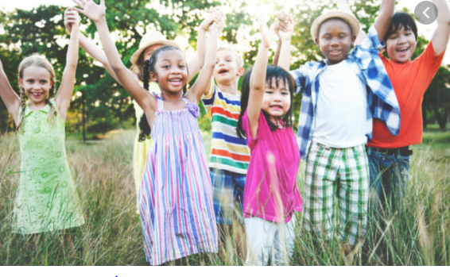
Connect us
Play ‘Simon Says’. Preface the statement with Simon and the children must do the activity i.e. “Simon says do star jumps”. If you say “Do star jumps” without saying “Simon says”, they must stand still.
Use active instructions like ‘Jump up and down on the sport’, ‘Touch your toes’, ‘Shake your arms in the air’, etc. Ask the children how they felt after playing this. Ask the children what is happening to their hearts. Can they feel their lungs taking in more air (oxygen)? Why are out hearts beating faster and our lungs working harder to get more oxygen?
Explain that exercise helps our bodies become fitter, especially our hearts and lungs so the right amount of exercise is a good thing to help our bodies stay healthy. We know when exercise has been good enough because we can feel our hearts beat faster and our lungs work harder.

Slide 4
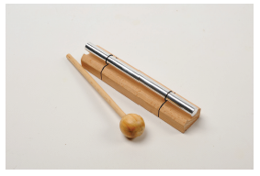
Calm me
Everyone, including adults, is sitting on chairs in a circle. Remind the children that at the beginning of every PSHE lesson we will help our minds calm down so that we are ready to learn.

Slide 5
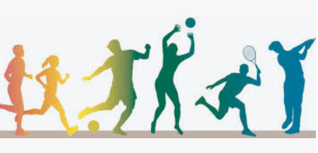
Open my mind
As a class, think of as many different sports/physical activities as possible and write list on flip chart/ whiteboard. Encourage the children to be creative with their ideas and not to just think of sporting activities. Many everyday activities are also good at exercising our bodies e.g. walking to school, helping in the garden, housework etc.

Slide 6
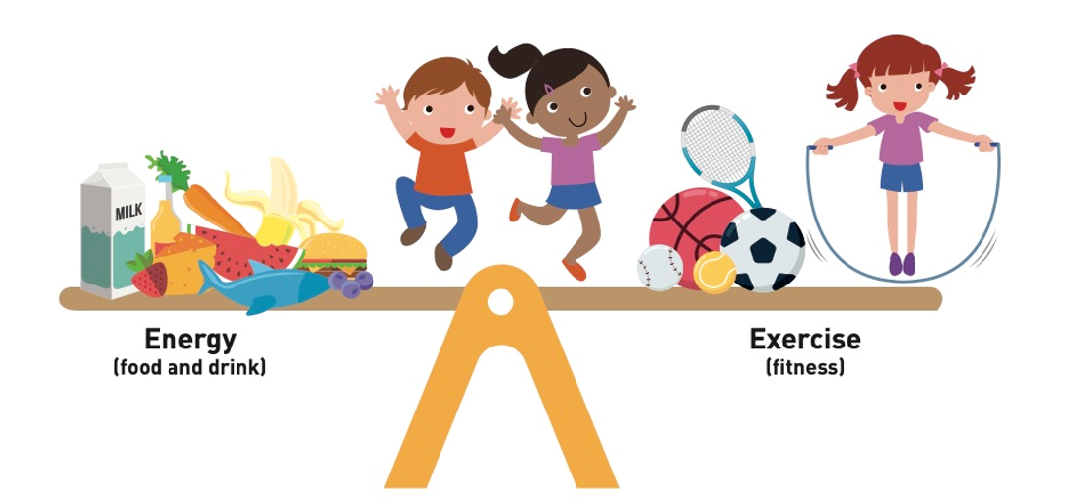
Tell me or show me
Show the children the PowerPoint slide ‘My body in balance’. Invite the children if they understand what the PowerPoint slide is showing them. Explain that our bodies need energy to work, grow and exercise; and that energy comes from food and drink (calories or kilojoules). Our bodies also need to exercise to stay healthy. Our bodies are ‘in balance’ (healthy) when we take in the right amount of energy and do the right amount of activity to use it. So the see-saw would be balanced.
Invite the children to say what might happen if a person took in too much energy and didn’t exercise enough. Would the see-saw tip one way? How could a person’s health be affected?
How about if a person exercised too much but didn’t take in enough energy? What would happen to the see-saw then? How could a person’s health be affected?
Can a person put their ‘see-saw’ back into balance if they have tipped one way or another? How could they do this?

Slide 7
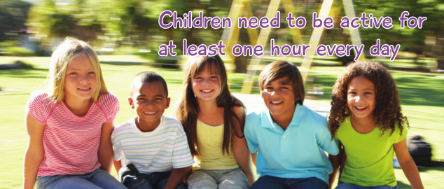
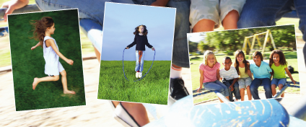
Let me learn
Show the PowerPoint slide: ‘Children need to be active for at least one hour every day’. Explain that this is a minimum and they can always do more. Say that the hour can be made up of lots of different chunks of time and activities throughout the day. Ensure the children understand that they can choose what activities they do in order to keep their bodies healthy.
Explain that everyone is going to make up their own fitness challenge: everyone’s fitness challenge will be different and will be unique to each person because our bodies are individual.

Slide 8
Hand out a Fitness Challenge Template to each child. Ask them to think about something thing they can do now without stopping for a break: play football for half an hour, skip with a rope for 10 minutes, do jumping jacks for 2 minutes, hop on the spot 20 times, run really fast between two points, etc. Children draw or write what they can do now and how many they can do or for how long/how far, in the first row of the template. They then think about how they can challenge themselves. Explain that their challenges need to be realistic and manageable. Draw or write in the second row of the template what they would like to be able to do and how many/how far/for how long: skip with a rope for 15 minutes without stopping, hop on the spot 30 times, etc. Encourage the children to be creative with their ideas.
Explain that the other rows in the template are left blank for now, so that when they achieve their challenge, they can add a new one underneath to keep getting fitter.
Tell the children that they can work on their fitness challenge at break times and at home. Ask for some of the children’s fitness challenge ideas by taking feedback from the class.

Slide 9
Year 4 Classes – Relationships
Please teach me to…
recognise situations which can cause jealousy in relationships
identify feelings associated with jealousy and suggest strategies to problem-solve when this happens
Vocabulary
Relationship
Close
Jealousy
Problem-solve
Emotions
Positive
Negative
Share the ‘Learning Charter’ – How we learn together

Slide 10

Connect us
In a circle, children pass an object e.g. a ball, to their neighbour without using their hands or arms. In pairs ask the children to discuss how a friendship/relationship can change. Give 2 minutes thinking time and then pass the ball around the circle to share ideas.

Slide 11
Everyone, including adults, is sitting on chairs in a circle.
Remind the children that at the beginning of every PSHE lesson we will help our minds calm down so that we are ready to learn. Tap the chime bar.

Slide 12
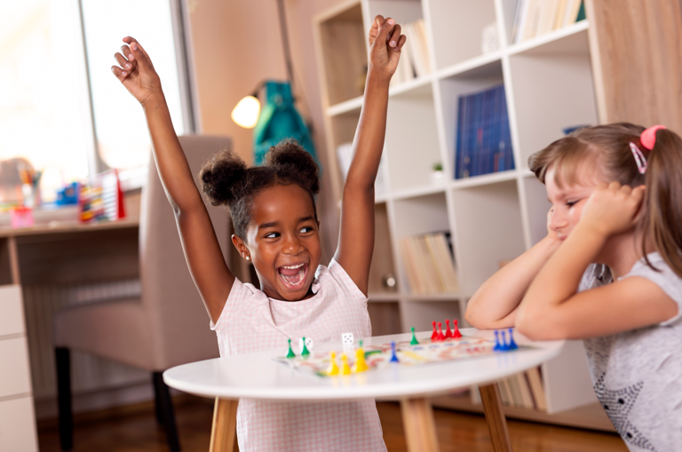
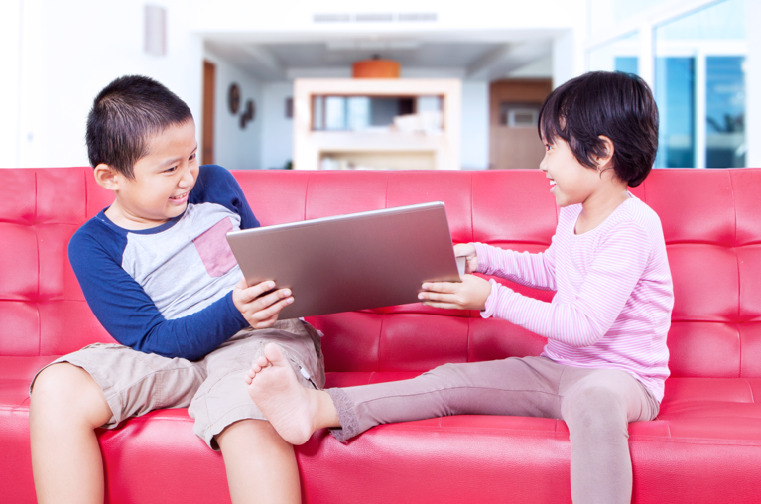
Open my mind
Show the children the photos in the ‘Jealousy PowerPoint’ and ask them to briefly discuss in their pairs what they think is going on in each picture, and how the people are feeling. Can they work out a connection between all the images?
As a whole class, discuss their ideas and draw out that the connection is jealous behaviour. Ask the children if they know what jealousy is and how it can feel. Explain that jealousy is a common emotion but an unhelpful one. We can all experience it about people and things.

Slide 13
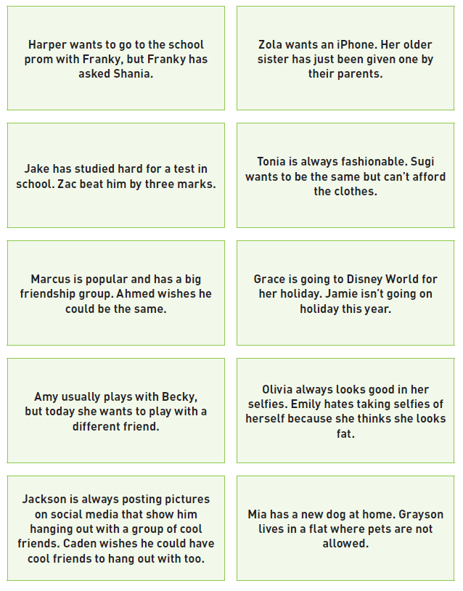
Tell me or show me
Share the ‘Situation cards’ with the children and explain they are going to sort them into two piles:

Slide 14
1) Situations that could cause a lot of jealous feelings
2) Situations that could cause fewer jealous feelings
Divide the class into groups and give each group a set of cards to sort.
When completed, discuss the differences in the groups’ decisions and the reasons why they sorted the cards as they did.
Discuss what causes jealousy and that it can stem from:
• A desire to have what someone else has
• Feeling threatened that we will lose something
• Feeling unhappy with our life and comparing with someone else
• Feeling that we deserve something and it’s unfair if we can’t have it
Explain that jealousy can be damaging to relationships because the person who is feeling jealous can behave unhelpfully towards the other person/people, or even towards themselves. It can often result in anger or anxiety. Referring to the scenarios, ask the children if they can suggest some examples to illustrate this type of behaviour, and any possible consequences of this. e.g. in the prom scenario, Harper might start acting cruelly towards Shania, and it could end up in a bullying situation.

Slide 15
Invite the children to pause for a moment. Invite the children to take three gentle, deep breaths. While the children are pausing, invite them to reflect on what they are thinking and feeling right now. They can keep these ideas in their heads and don’t need to share.

Slide 16
Let me learn
Allocate one of the scenarios to each group. Set the groups a challenge to problem-solve the situation on their card. Can they suggest a way forward so the situation can be resolved? Is there a way to manage the jealousy so it doesn’t result in unhelpful behaviour?
Give each group a few minutes discussion time, then ask for feedback.
Make a list of the children’s strategies on the board. Ensure the following have been suggested (by you or them) in the list:
• Don’t keep the feelings bottled up inside, talk to someone about how you are feeling.
• Try not to ‘blame’ the other person/people. It may not be their fault and they may not have done anything deliberately.
• Problem-solve using the ‘Mending Friendships/ Solve it together’ ideas
• Look at the situation and ask if it is true or fake e.g. social media doesn’t always show the ‘real’ picture because people can choose what and what not to post. Some people alter their photos etc.
• Try not to compare, you are being unfair to yourself.
• Use your Calm Me breathing to calm your thoughts and feelings down before assessing the situation.
• It might be something that you can’t change, so move on and try not to worry about it.

Slide 17
Year 5 Classes – Changing Me
Please teach me to…
be aware of my own self-image and how my body image fits into that
know how to develop my own self esteem
Vocabulary
Self
Self-image
Body image
Self-esteem
Perception
Characteristics
Aspects
Affirmation
Share the ‘Learning Charter’ – How we learn together

Slide 18

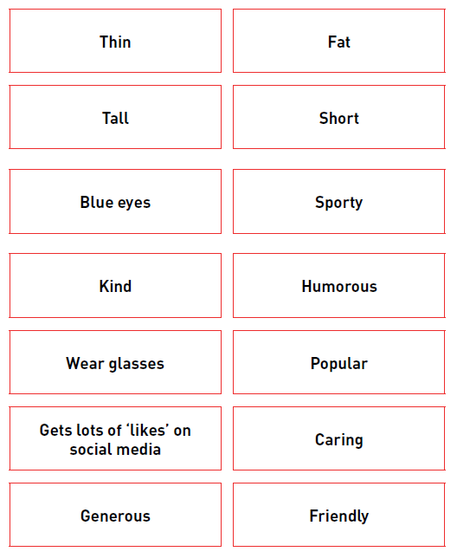
Connect us
Label two ends of the room, one with a smiley emoji and one with a sad emoji. Using the self-image cards ask for a class consensus to place the cards near the happy face or the sad face according to their perceptions of whether that aspect of self-image is positive or negative.
This activity should generate discussion as there is no right answer.

Slide 19
Everyone, including adults, is sitting on chairs in a circle.
Remind the children that at the beginning of every PSHE lesson we will help our minds calm down so that we are ready to learn. Tap the chime bar and listen.

Slide 20
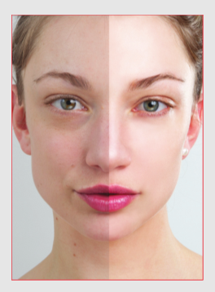
Open my mind
Help children question why they have these perceptions from the Connect us game and where they may have come from. Raise the issue of body image expectations and what is shared online and in social media. How real are these images and how much are they airbrushed / using filters to change the appearance? Share some images that you have sourced from online of celebrities the children know. Can they tell if these images have been altered? There are some images online that also show the ‘before’ and ‘after’ airbrushing.
These are also good to show to reinforce the point that what we see online may not always be a true perception. In addition, explain that celebrities have professional teams to work on their appearance and
have a lot more money to spend on clothes etc. This is unrealistic for the majority of people. Why is it then unfair to compare ourselves with what we see online or even against our friends? There is one before/after picture included in case you find it difficult to source pictures.
Ask the children if someone disliked their body image, what could images like this do to their wellbeing and self-esteem? Draw out that it could affect their mental health and physical health e.g. going on an extreme diet when it is not needed, or leading to anorexia or bulimia. Make the point that both males and females are affected by this, and that it is NOT just a ‘girl thing’.

Slide 21
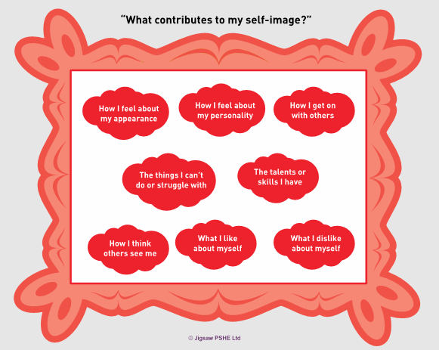
Tell me or show me
Using affirmations is a simple technique to help transform negative self-image into positive self-image which in turn raises self esteem. Ensure you distance this from the children by using generic examples. On the board write an example of a negative aspect of self-image, e.g. I am heavier than I want to be. Ask the children how they could change this negative statement into a positive one to help the person feel better. e.g. “I feel healthy and like how I look”. To make the negative self-talk turn to positive you have to write the affirmation as if what you want to happen is already the reality.
Show the children the ‘Self-image’ picture frame template. Explain these are just some of the factors that make up our self-image. Discuss that all of us have a picture inside us of how we see ourselves.
This is called ‘our self-image’ and only we know about it. Our friends may see some of this but we may keep some of it hidden.

Slide 22
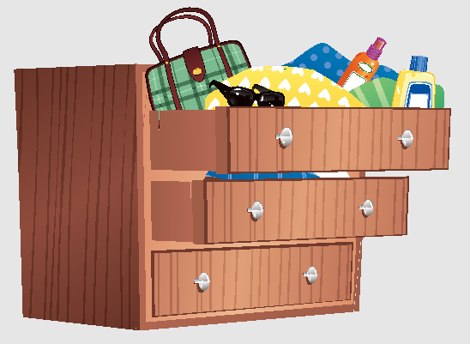
Chest of drawers.
Explain that we are like a chest of drawers. There is some information about us we don’t mind everyone knowing (top drawer), there are some aspects of ourselves we only show to chosen people (middle drawer), and there are some things about us we don’t let people see (bottom drawer).

Slide 23
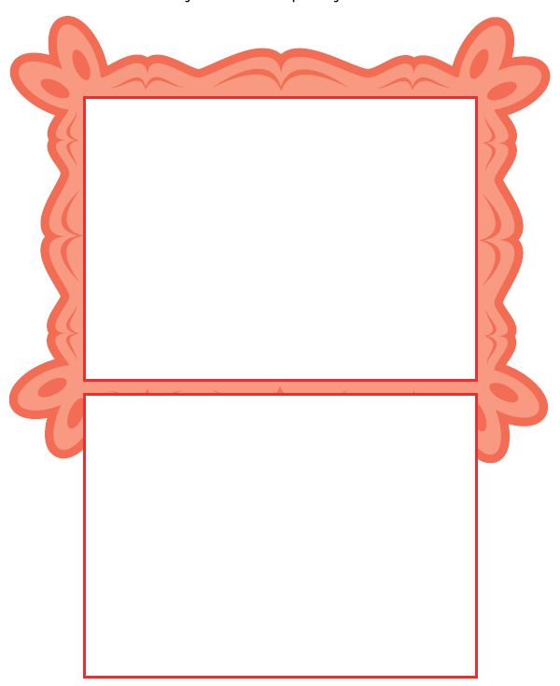
Let me learn
Step 1) Ask the children to work individually and to write ten words/ phrases inside the picture frame template that best describe the internal picture (self-image) they hold of themselves.
Step 2) When they have done this, ask them to draw a smiley face by the words that describe the parts of themselves they are happy with and a sad face by the words that describe the aspects of themselves
they are unhappy about.
Step 3) Ask them to reflect on the balance between smiley and sad faces? (Be aware that this process could be painful for some children and be ready to support them). Explain to the children that the happier they are with their self-image, the better their self-esteem will be. Explain that our self-image doesn’t remain static and can and alter with time and in response to experiences, so it is helpful to try and be mindful of our self-image and to boost it whenever we can by using
positive affirmations.
Step 4) Children can work individually, or with a friend if they choose to,
and take one of their self-image words that they put a sad face by and
change it into a positive affirmation. Help them to understand that if they
change the negative perceptions of themselves into positive i.e., they can
see themselves in a more positive way, this could raise their self-esteem.
If time, they can repeat this process with other sad face words.
Ensure that every child has turned one negative into a positive by the
end of the lesson, so it ends on an upbeat note with children feeling
good about themselves.

Slide 24
Year 6 Classes – Changing Me
Please teach me to…
identify what I am looking forward to and what worries me about the transition to secondary school /or moving to my next class
know how to prepare myself emotionally for the changes next year
Vocabulary
Transition
Secondary
Looking forward
Journey
Worries
Anxiety
Hopes
Excitement
Share the ‘Learning Charter’ – How we learn together

Slide 25
Connect us
Pass the talking object around the circle and ask the children to name one highlight from this year and one thing they are looking forward to next year. Play the children’s favourite Connect us game.
Calm Me
Everyone, including adults, is sitting on chairs in a circle.
Remind the children that at the beginning of every PSHE lesson we will help our minds calm down so that we are ready to learn. Tap the chime bar and listen.

Slide 26
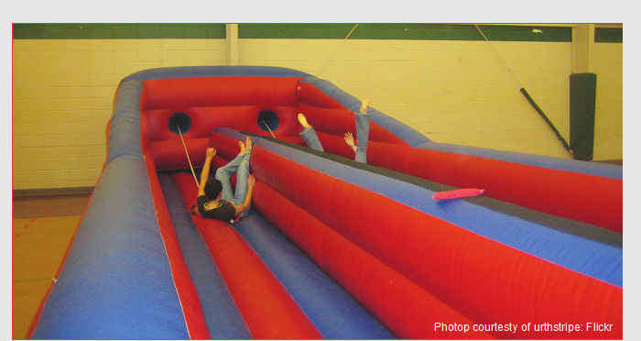
Open my mind
Slide 1: Show the PowerPoint slide of an inflatable bungee run and, in talking partners, ask the children to suggest ways in which the bungee run is a symbol of them starting their next year in secondary school
What could the bungee run mean? (They are looking forward but maybe are being held back by some fears or concerns like the bungee cord around their waist.)

Slide 27
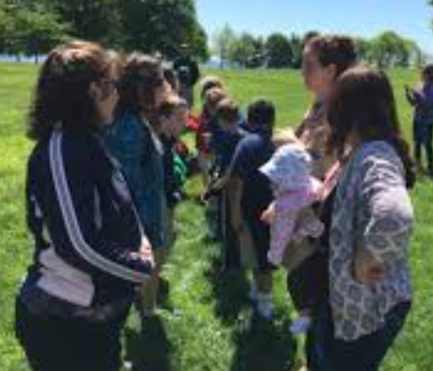
Tell me or show me
Play ‘Bin the worry’ game. Each child has a piece of paper and a pen. Invite them to write their biggest worry about the next school year on their paper. (Make sure they know they will be asked to share these as this may make a difference about what they choose to write.)
Working in groups of six, children take it in turns to journey through ‘solutions alley’. Each group arranges itself in two lines, with pairs facing each other. In turn, each child stands at one end of ‘solutions alley’ with their worry written on paper, and asks the others to suggest solutions for that worry - “Please can you help me bin this worry”. As the child slowly walks through the alley, the members of their group in turn offer a solution to their worry. When they get to the end of the alley, they consider the suggestions; if they have found a possible solution they can choose to ‘bin the worry’ by screwing up
the worry and putting it in the bin. If no adequate solution seems to
have been found, this can opened to the rest of the class for
suggestions (as long as the child agrees). It may be necessary
for the teacher/pastoral care worker to follow this up if a
concern hasn’t been addressed.

Slide 28
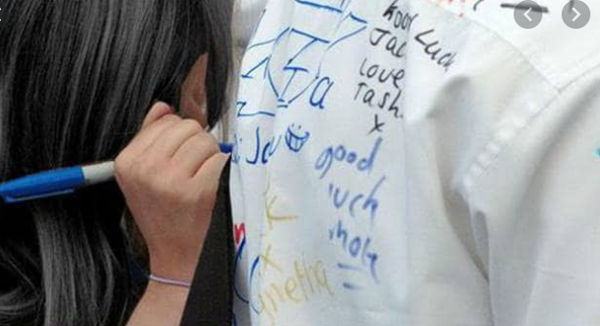
Let me learn
As this is the children’s last year in primary school, it is a ‘tradition’ in our school for the children to get a piece of their uniform signed.
Ask the children to also include reflections on their best moments and memories. Put them in groups so they can reflect together and remind each other. Also ask them to include some of the things they are looking forward to next year.
Share the children’s ideas and celebrate

Slide 29
Change the atmosphere of the room using the chime and a breathing technique to help children enter a reflective state. Ask them to visualise three things they are most looking forward to about their next year in school and to be aware of the positive emotions attached to those things.
Gently bring them out of the reflection using the chime.

