Slide 1

Examples of our PSHE Lessons
Reception and Key Stage One

Slide 2
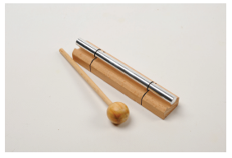
Reception Classes – Being Me in My World
Learning Challenge - How am I feeling today?
Calm Me Time
Everyone sitting in a circle, including the adults, explain to the children about a special chime bar that gives a calm and peaceful sound.
Tap the chime bar, encourage the children to breathe in through their nose and out through their mouth whilst listening to the sound of the chime bar. They touch their noses as they breathe in and put their hands in front of their mouths as they breathe out so they can feel their rainbow breath.
Sound the Chime again and ask the children to listen until they can no longer hear it and explain that Calm Me time is over.
How do they feel?
Can they use words like calm, peaceful and quiet?

Slide 3
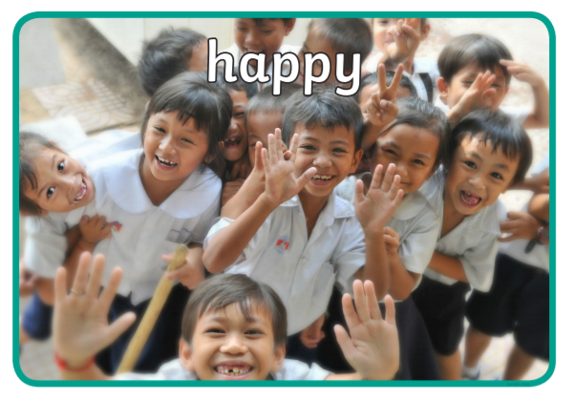
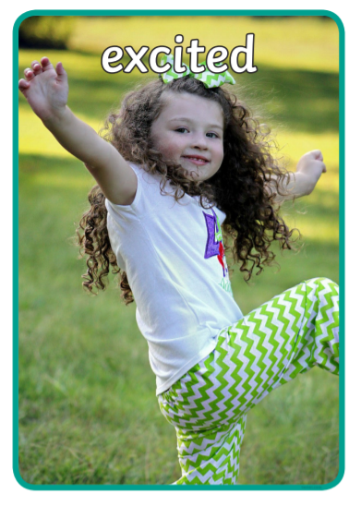
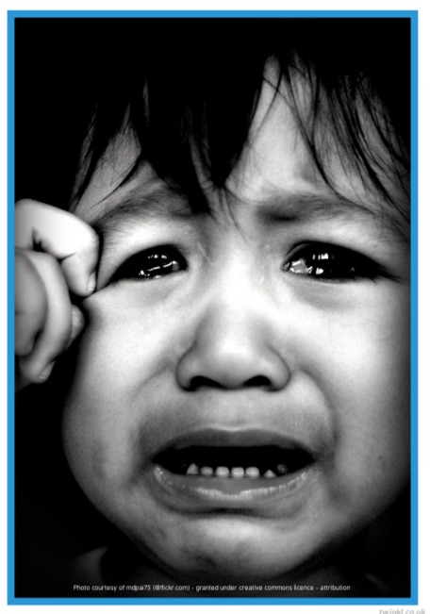

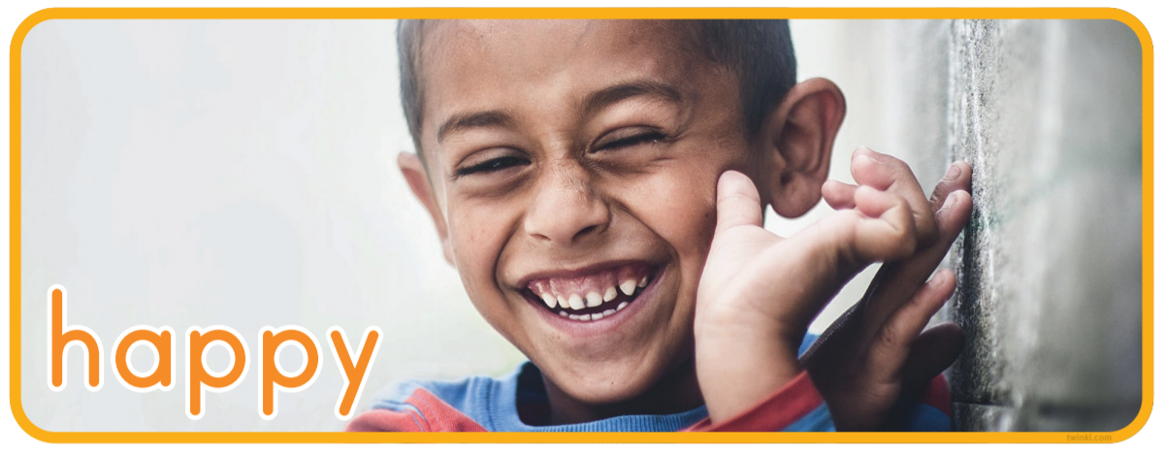
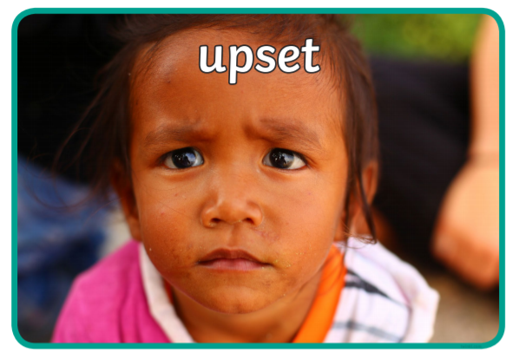
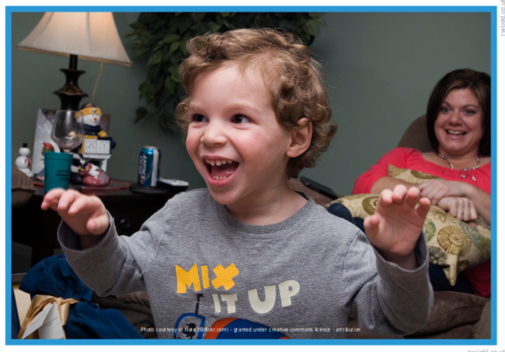

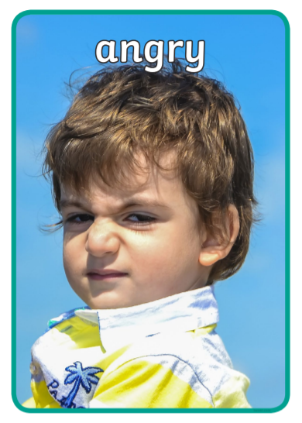
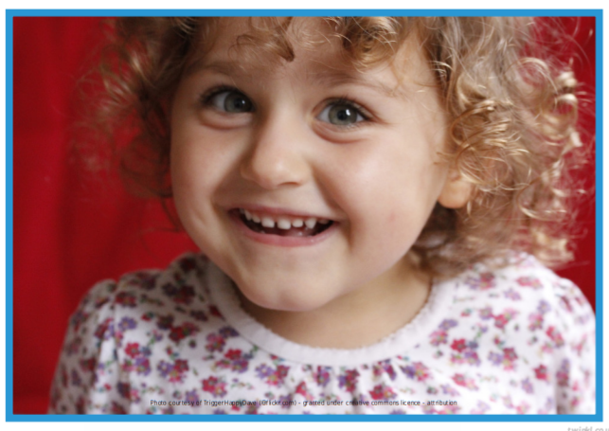

Have a selection of emotion photographs on the floor and together sort them into similar emotions

Slide 4
Choose the pictures of the children showing emotions.
‘All these children have just started school or nursery for the first time. Look at the photographs and encourage the children to name the emotion they are feeling. Pass the ‘talking object’ around the circle and encourage the children to share ‘I was happy when…..’ ‘I was angry when…..’
Questions – Why do you think these children are feeling happy/sad/excited/angry?
If you are feeling sad/angry what could you do to feel better? Discuss strategies with the class. Explain that we all have a job as the reception class to be kind friends. Introduce the phrase ‘I you see someone without a smile, give them one of yours.’ Play a game of pass the smile around the circle.

Slide 5

Year 1 Classes – Celebrating Differences
Please teach me to…
identify similarities between people in my class
tell you some ways in which I am the same as my friends
Vocabulary
Similarity/similar
Same as
Share the ‘Learning Charter’ – How we learn together

Slide 6
Play ‘Switch.’
The aim of this game is for children to gain awareness of the similarities and differences between them, particularly the similarities. Therefore, throughout the game the teacher needs to keep drawing children’s attention to the others who ‘switched’ at the same time as them, thereby helping children get to know with whom they have things in common (e.g. “Did you notice who also switched when I asked who has a pet gerbil?”).
Play the game: Sitting in a circle the teacher explains to children that when they call out a statement that applies to them, they need to ‘switch’ places with someone else to whom it also applies. The teacher may call out, “Switch places if you like jelly babies”. All the children who like jelly babies switch places and notice who else likes jelly babies. Continue the game with a range of statements such as: Switch places if you like football, switch places if you like computer games, switch places if you have long hair, etc

Slide 7
Everyone, including adults, is sitting on chairs in a circle.
Remind the children that at the beginning of every PSHE lesson we will help our minds calm down so that we are ready to learn. Tap the chime bar.

Slide 8
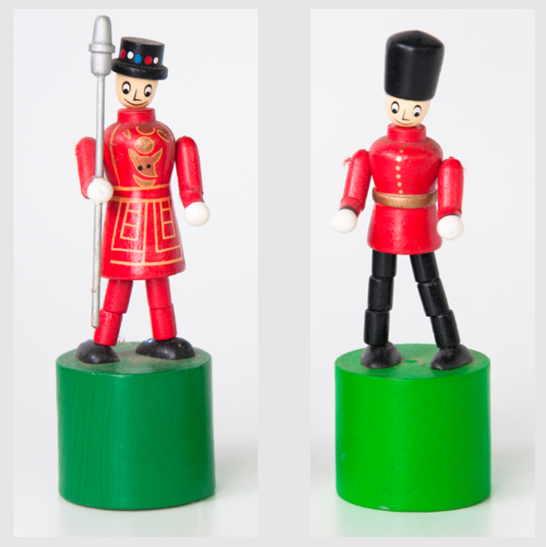
Spot the similarities on two pictures. This is like spot the difference, but here the focus is on what is the same. Ask the children to identify the similarities and reinforce the language: “The same as…” and “Similar to...”.

Slide 9
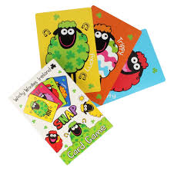
Tell me or show me
Use a set of cards with animals or characters on, e.g. Snap or Happy Families. Give each child a card and ask them to find their pair.
Ask a pair to come out to the front and then ask the other children to see what is the same for the two children standing out the front. For example, both have blue eyes. Draw out similarities that might not be visible, e.g. likes, hobbies, family composition, etc.

Slide 10
Invite the children to pause for a moment. Invite the children to take three gentle, deep breaths. While the children are pausing, invite them to reflect on what they are thinking and feeling right now. They can keep these ideas in their heads and don’t need to share.

Slide 11
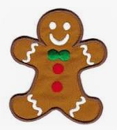
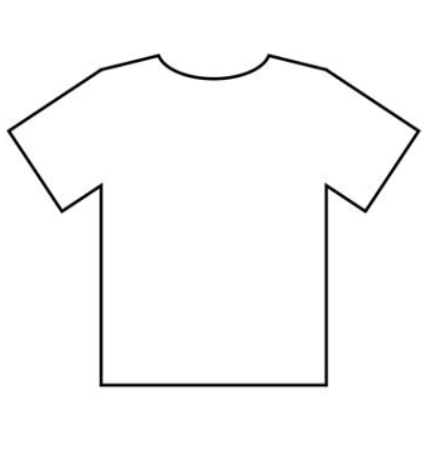
Let me learn
Still in the same pairs, children identify three similarities or ways that they are the same as their partner. Share these in the circle, ensuring that all children have grasped this concept.
Back at their tables and sitting with in their pair, give each child a T-shirt template for a gingerbread person (make sure the child’s name is already written on the T-shirt template). Explain that each child has a gingerbread person and this T-shirt is for their gingerbread person. Ask children to draw/write onto their T-shirt template three ways they are similar to the partner with whom they are working.

Slide 12
Year 2 Classes – Dreams and Goals
Please teach me to…
choose a realistic goal and think about how to achieve it
tell you things I have achieved and say how that makes me feel
Vocabulary
Realistic
Proud
Success
Celebrate
Achievement
Goal
Share the ‘Learning Charter’ – How we learn together

Slide 13
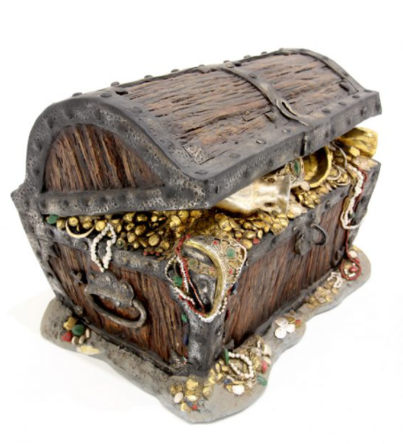
Play ‘Pass the treasure chest’. Sitting in a circle, the children pass a treasure chest (filled with beads, marbles, coins, coloured stones). Set the class the goal of passing it all around the circle without making a sound. Can the children suggest ideas that would make this possible? Can they work together to achieve this goal? Is this a ‘realistic’ goal?

Slide 14
Everyone, including adults, is sitting on chairs in a circle.
Remind the children that at the beginning of every PSHE lesson we will help our minds calm down so that we are ready to learn. Tap the chime bar and listen.

Slide 15
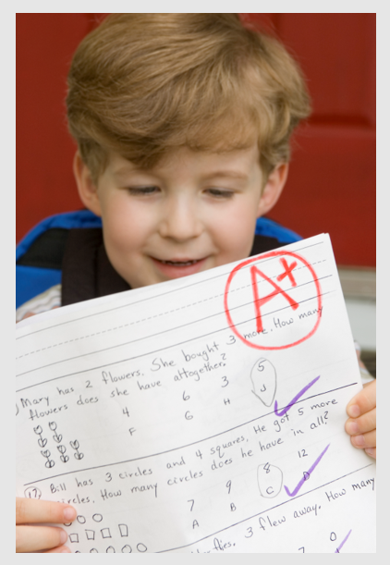
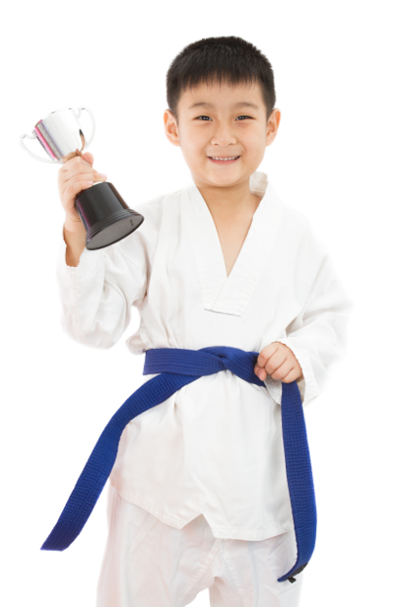
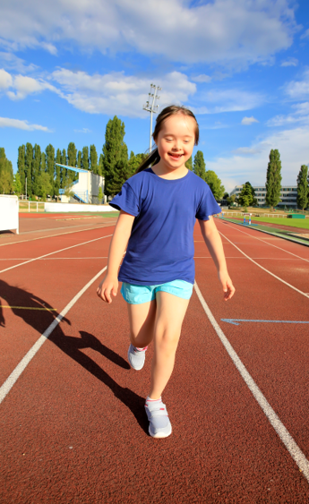
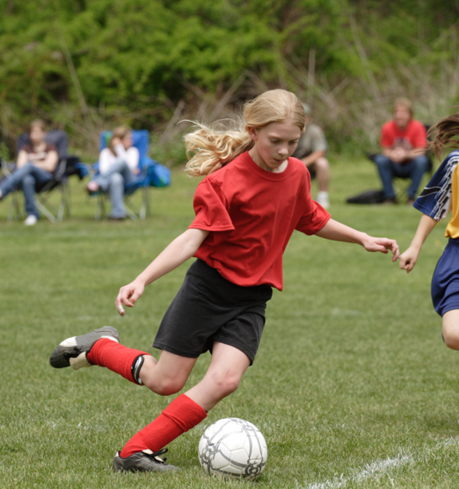
Put the treasure chest in the middle of the circle, show children the ‘success’ pictures one at a time and ask them the question: Do you see success in this picture? Why or why not? If yes, how do you think the people in the picture feel about their success? (Ensure the children understand that feeling proud of success is a
positive feeling.)
The pictures that show ‘success’ are then placed in the treasure chest of success. (Help the children start to associate the treasure chest with success and ensure they understand what success means. It may be possible to interpret the pictures in a number of ways, e.g. a goal keeper may have let a goal in but maybe successful
because s/he is in the national team.)

Slide 16
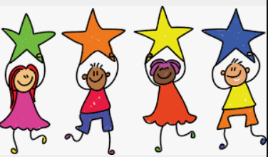
Tell me or show me
Invite the children in talking partners to share something they have achieved and felt proud about. Once all the children have an idea, pass the talking object around the circle and invite each child to share their success and their feelings about it.
Summarise by explaining that we can store these proud and positive feelings inside us. Ask the children to imagine they have a treasure chest inside them and they are storing their special feelings inside.
(You could ask children to mime their successes for others to guess).

Slide 17
Invite the children to pause for a moment. Invite the children to take three gentle, deep breaths. While the children are pausing, invite them to reflect on what they are thinking and feeling right now. They can keep these ideas in their heads and don’t need to share.

Slide 18
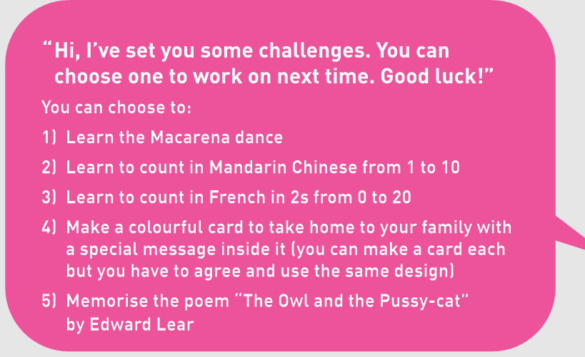
Let me learn
Hand out a treasure chest template to each child and invite them to complete the sections explaining their success and the feelings they would like to store inside like treasure. Show the list of challenges they can choose from on the PowerPoint slide. Explain to the children they need to think which challenge they would enjoy and which are realistic for them to achieve.
Ask the children if they know what realistic means and explain that if we choose challenges that are too easy, they aren’t really a challenge. If we choose something very difficult it might take a long time to achieve, or it might end up being too difficult for us. Explain that challenges are very personal. What one person finds difficult another person might find easy. Can the children think why that might be? Ask each child to decide which realistic challenge they would like to attempt.

