Slide 1
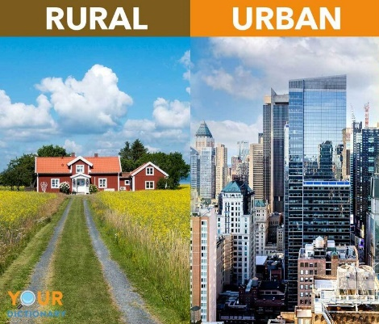


Maths
This half term the children will continue to develop their understanding of decimals, including using formal methods to add and subtract. They will also look into negative numbers and converting units.
Geography
Land use
The children will learn look at the rural and urban land use within the UK. They will also create a sketch map based on the local area.
Science
Animals including humans
The children will learn about animals including humans. They will look, in detail, at the different stages in a humans life cycle. Additionally, they will look at the gestation periods and life span of different animals.
Year 5
English
The Invention of Hugo Cabret
This half term the children will continue to explore the novel The Invention of Hugo Cabret and write a mystery story
.
DT
Mechanisms
The children will explore cams and pulleys to create our very own punishment machine based on our crime and punishment topic last half term.
Summer
2

Slide 2



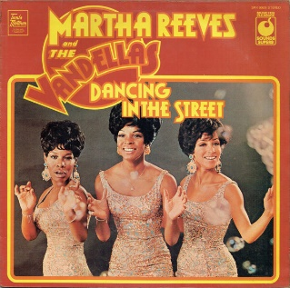





​
​
​
PE
The children will learn skills in cricket and gymnastics.
Music
The children will be listening to and learning ‘Dancing in the Street’ By Martha and the Vandellas
ENRICHMENT
Linking Project!
Key Text
Computing
Programming B
The children will be looking at conditions within programming and will design their own quiz based on true or false questions.
RE
Judaism:
Do people need laws to guide them?
PSHE
Changing me
The children will be considering how media can have influence on your body image. We will also have a visitor to explain how the body changes as they develop into an adolescent.
French
Eating out
The children will learn about places to eat and food on the menu.

